Slide 1
Witches – daughters of the devil

Slide 2
Witch Hunts
During the 15th and 17th Centuries in Europe, it is estimated the between 100,000 and 300,000 people were killed and more than twice this number were imprisoned or banished because they were accused of witchcraft.

Slide 3
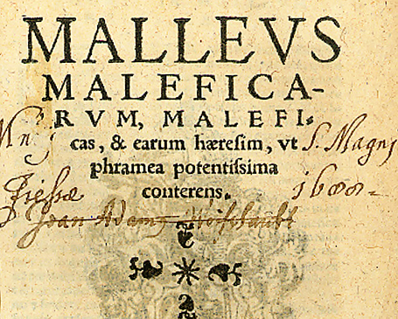
“The Witches Hammer”

Slide 4
“The Witches Hammer”
The Malleus Maleficarum is a famous treatise on witches, written in 1486 by Heinrich Kramer, an Inquisitor of the Catholic Church, and was first published in Germany in 1487. Jacob Sprenger is also often attributed as an author, but some scholars now believe that he became associated with the Malleus Maleficarum largely as a result of Kramer's wish to lend his book as much official authority as possible.
The main purpose of the Malleus was to attempt to systematically refute arguments claiming that witchcraft does not exist, discredit those who expressed skepticism about its reality, to claim that witches were more often women than men, and to educate magistrates on the procedures that could find them out and convict them. Kramer was denounced by the Inquisition in 1490.

Slide 5
“The Witches Hammer”
The Malleus Maleficarum asserts that three elements are necessary for witchcraft: the evil-intentioned witch, the help of the Devil, and the Permission of God.
The treatise is divided up into three sections.
The first section tries to refute critics who deny the reality of witchcraft, thereby hindering its prosecution.
The second section describes the actual forms of witchcraft and its remedies.
The third section is to assist judges confronting and combating witchcraft.
However, each of these three sections has the prevailing themes of what is witchcraft and who is a witch. The Malleus Maleficarum can hardly be called an original text, for it heavily relies upon earlier works such as Visconti and, most famously, Johannes Nider's Formicarius(1435)

Slide 6
Causes for witch hunts
Read through Witch-hunts during the Renaissance.
As you read, think about what the hypotheses could be as to why the witch-hunts occurred.
In small groups, generate possible explanations for the witch-hunts and find evidence to support the explanation.

Slide 7
In class multi-paragraph assignment – witches essay
In a multi-paragraph answer, summarize the causes of witch-hunts during the Renaissance. In your last paragraph, decide which of the causes is the most important and evaluate why.
10 marks will be assigned on the quality of your summary of the causes (try to summarize all four causes in one paragraph). 5 marks will be assigned to your last paragraph where you must properly evaluate the single cause you believe is most important. In this paragraph you must state why this reason for the witch hunts is more important than all the other reasons.
As well, your mark will be based on proper paragraph format, grammar, and punctuation.
This assignment will be worth 15 marks.

