Slide 1
Why was Europe on the Edge for So many Revolutions?
Changing Nations
Changing Technologies
Changing View points

Slide 2
Changing Nations: Kings and Religion
Divine Right of Kings
Kings believed they were appointed to their position by God
Kings believed that their actions could only be judged by God
They had special rights and thought themselves above the laws of their nations.
Why might this attitude become problematic in the future?
New Organization of Political Systems
Nation-States now existed (what is a nation state?)
Kings appointed people to positions of office
Kings paid people in these positions, making them loyal to him
Nobles no longer assumed political offices and thus their power is weakened
Armies were paid
People were subjects to the king, and not bound to a noble.
Why is this new system of organization different, than say feudalism?

Slide 3
Changing Nations: Kings and Religion
Revolution in the Church
The Renaissance saw a decrease in faith in the Roman Catholic Church
The Catholic Church was seen by many as corrupt, wealthy, and too powerful.
Challengers to traditional and established thought appear
Martin Luther
Johannes Calvin
Zwingli
Henry VIII
Divisions between the followers of the Catholic faith and the new PROTESTANT faiths grow and cause conflict across Europe

Slide 4
Changes in Trade and Agriculture: Farming methods and Exploration
As a result of the Black Plague, farmers were more valuable and were paid for their work.
Larger farms appeared that concentrated on one crop in particular
Higher yields of food were produced with new inventions
Because of exploration, there was the introduction of new crops from the Americas
Explorers wanted to find a route to India and China – they found North and South America
Explorers then claimed land for European countries and a system of colonies appear.
What could be some consequences of Colonization?

Slide 5
Changing View Points: People and the World Around Them
Thanks to the Renaissance, people began to be curious about how they fit into the world and what they were able to do.
Humanism became very prevalent in artwork and literature.
What is Humanism?
What themes are now being seen in art and literature?
Books were being written on a more frequent scale and for more people.
What things would make books more accessible to more people?
Why is it potentially dangerous to have literature more accessible to more people?

Slide 6
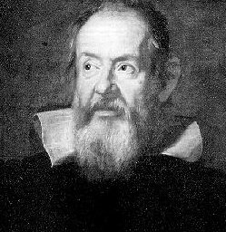
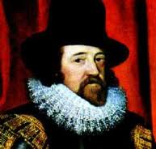
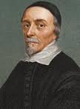
Changes in Science and Technology
Because of Humanist ideals and the access to ancient writings, scientists began to question prior knowledge.
Previous views of the natural world were challenged and often, found very wrong.
New tools of discovery were created.
Scientific method was used to prove the theories of scientists.

Slide 7
SO WHAT?
Why will these changes influence people to want to overthrow their existing systems?
Do you see a common thread through the types of Changes?
How does Humanism spark change and revolution?

Slide 8
What is your revolution?
You’ve worked in a group to create a given revolution, but what is a change in the world that you would like to see happen?
What are you passionate about? What is your cause? What needs to be changed? How can it be changed?
Your assignment is to create a short article or speech explaining a cause that you are passionate about and that you want to see changed.
Both the article or the speech must:
Identify your cause (2 marks)
What the problem is with it (4 marks)
How it can be changed (4 marks)
What the benefits of achieving change would be (4 marks)

