Slide 1
The Progression of the French Revolution

Slide 2
Remember the causes
Political – feudalism & absolute monarch
Social – feudalism & major class divisions
The 3 Estates
The riding of the peasants
Economic – debts from war, extravagant spending, no central bank, no common currency, unfair taxes
Philosophical – enlightened thinkers, American Revolution influence.

Slide 3
The Stages of the French Revolution
Moderate stage – 1789 to 1792
Radical stage – 1792 to 1794
The Directory – 1794 to 1799
Napoleon – 1799 - 1815

Slide 4
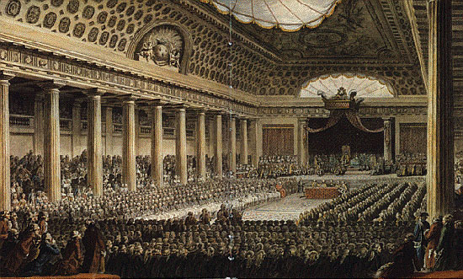
The Revolution began in 1789
Louis XVI had to call the Estates – General
Why do you think he might call it? Check page 73 & 74 for a clue!
This was the first time that the Estates- General had been called since 1614!
What were the Estates-General? Does this set up and process remind you of anything?
Each Estate elected delegates
The First Estate represented about 100,00 clergy
The Second Estate represented about 400,000 nobles.
The Third Estate represented about 24.5 million people, everyone from wealthy lawyers and government officials to poor peasant families.

Slide 5
When the Estates General finally met in the spring of 1789, there was disagreement about how they would vote.
Traditionally, each estate voted as a bloc, thus the upper two estates had twice as much voting power than the lower.
This time, the Third Estate argued that all delegates should vote as individuals and demanded as many delegates as the First and Second Estates.
Louis opposed the idea, then (as was his habit) changed his mind to allow this to happen.
He was not willing to give over all his power to the Estates, but allowed them say over smaller matters; like fixing the tax system

Slide 6
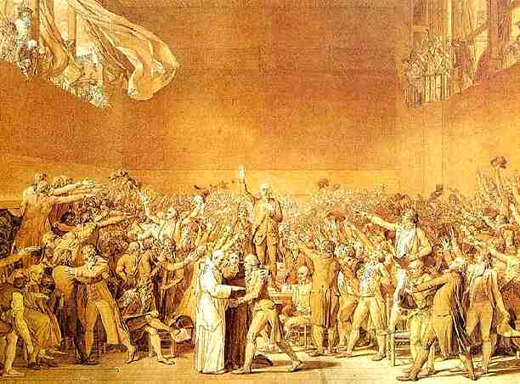
National Assembly “15”, King “Love” – the Tennis Court Oath
The progress towards democracy in France was moving too slowly, after 6 weeks of meeting at Versailles, the Third Estate broke away and declared themselves the National Assembly
Lead by Count Mirabeau, the members took the Tennis Court Oath (they had gathered in the tennis court at the palace)
They agreed not to disband until they had formed a new government.
King Louis XVI tried to offer some reforms, but he was rebuked and was forced to demand that the 1st and 2nd Estates join the National Assembly

Slide 7
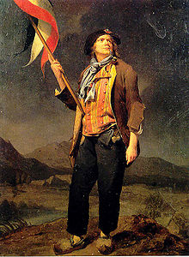
Actions and Reactions
People in Paris, the center of the 3rd Estate, were very aware of the events in Versailles.
Riots broke out in Paris and across the nation as bread prices soared
Rumors flew that the king was going to assemble his army and state a coup d'état
Workers in Paris – the Sans-Culottes – organized a militia of volunteers.
Why were they called the Sans-Culottes?
Hint look at his clothing

Slide 8
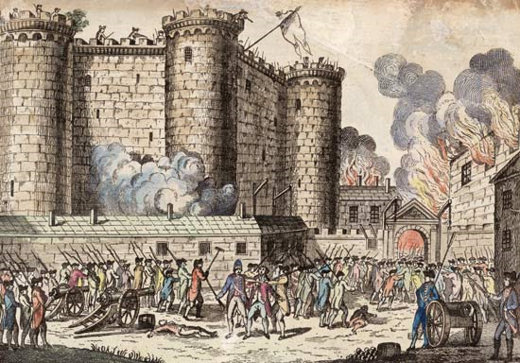
The Fall of the Bastille
On July 14, 1789 mobs of workers, lead by the Sans-Culottes, stormed the Bastille, the royal prison and fortress in Paris (a symbol of royal authority)
Gathering ammunitions, they tore it down brick by brick. It’s fall symbolized the people’s role in revolutionary change.

Slide 9
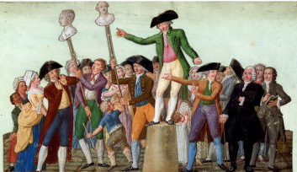
The Fall of the Bastille
Foreshadowing what would come later, the mob cut off the governor‘s head and stuck it on a pike, which was paraded around.
With the fall of the Bastille, Citizens determined to keep order in Paris formed the National Guard commanded by the American Revolution hero Lafayette

Slide 10
The Great Fear
Following the fall of the Bastille was the Great Fear. People in the countryside throughout most of France heard that the king’s armies and mercenaries were on their way
Peasants burned and destroyed the houses of aristocrats.
Look at the Map on page 76; The Great Fear spread to many areas of France… why not everywhere?

Slide 11
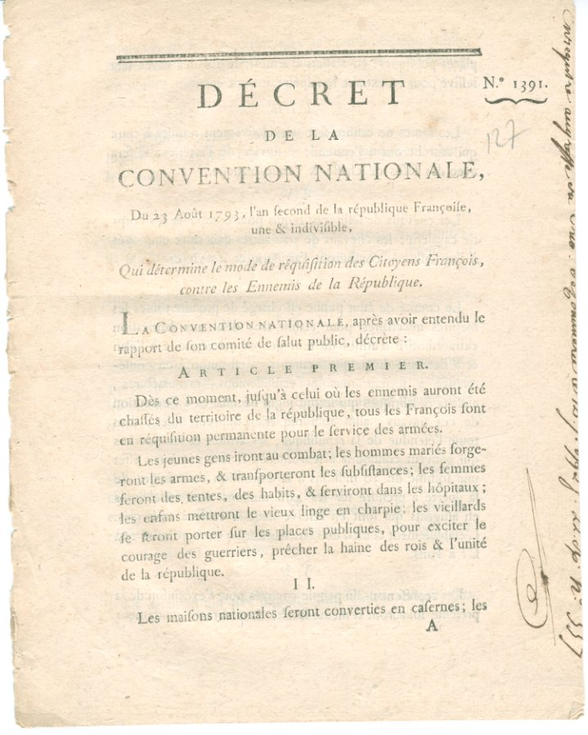
The August Decrees
August 1789, the National Assembly voted to abolish all noble and other privileges, including
Church tithes
Hunting privileges
Tax exemptions and monopolies
The remnants of feudalism

Slide 12
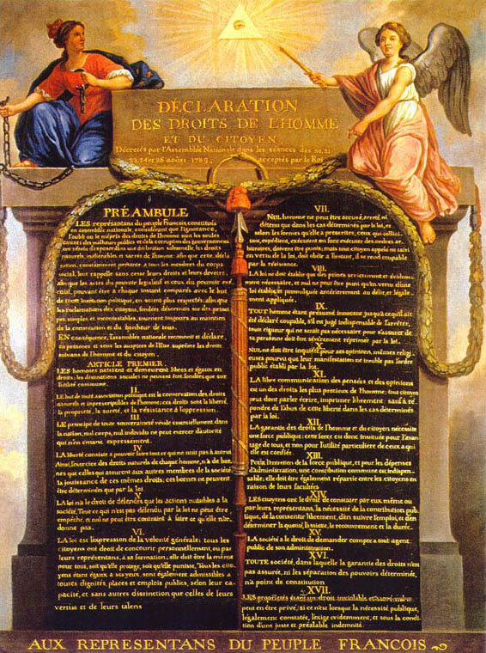
Declaration of The Rights of Man and the Citizen
The National Assembly signed the Declaration of the Rights of Man and the Citizen
The document declared the natural rights of the people of France: private property, liberty, security, resistance to oppression
It also declared freedom of speech, religious toleration, and freedom of the press.
Under the Declaration, all citizens were equal before the law.

Slide 13
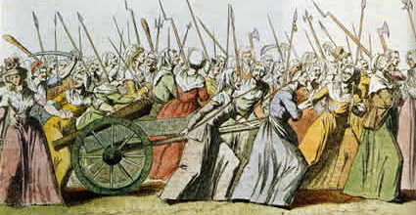
The March on Versailles, October 1789
Angered by the price of grain, economic troubles, and emboldened by the actions of the National Assembly, a large group of women, joined by supporters and the National Guard, marched the 50 kilometers to Versailles to demand that the Royal Family return to Paris to see what was really occurring in the Capital.
Look at this image in your textbook, pg 77.
What things do you notice about the people, their actions, their faces?

Slide 14
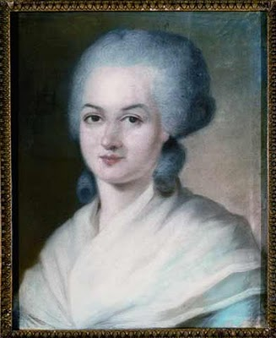
Women in the Revolution
Women participated in the Revolution in many ways
Joining and hosting clubs, debates, and demonstrations
They saw themselves as equals
In 1791, the Declaration of the Rights of Women and the Female Citizen was passed. It stated that women should have the same rights as men.
Olmype de Gouges writer of the Declaration of the Rights of Women and the Female Citizen

Slide 15
Follow up Homework
Read “Declaration of the Rights of Man and the Citizen” (pg 76) and answer the following questions:
Once the aristocratic titles were removed, what new title was put in place for the people of France?
What was to be done with Church properties? Is this a fair action?
For what reasons was Louis XVI tempted to leave France? What were the results?
When the Legislative Assembly formed on October 1, 1791, what issues faced the government? Why was the revolution in danger of failing?

