Slide 1
The Age of Revolutions

Slide 2
What is Change?
In your opinion – how can you define change?
Write your definition
Share it with a partner – are there similarities?
Are there things that you would like to see change?
Try to come up with a couple different things.
Share with a different partner
Now… think on a global scale… what things in the world do you think people want to see changed?

Slide 3
GOING AFTER
CHANGE IS REVOLUTION!

Slide 4
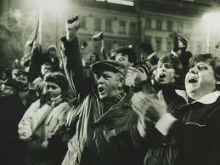
What is Revolution?
The are several reasons for why revolutions occur
Revolutions completely change or modify an existing system or constitution

Slide 5
What are some reasons that Revolutions start?
New ideas and New thinkers
Anger and discontent with the present establishment
Present needs of the people and population not being met
Violation of human rights
Nationalism:
the doctrine that your national culture and interests are superior to any other
the aspiration for national independence felt by people under foreign domination
the doctrine that nations should act independently (rather than collectively) to attain their goals
Imperialism:
a policy of extending your rule over foreign countries
a political orientation that advocates imperial interests
any instance of aggressive extension of authority
Colonialism:
exploitation by a stronger country of weaker one; the use of the weaker country's resources to strengthen and enrich the stronger country

