Slide 1
Power of the Church
All for the Glory of God

Slide 2
Hierarchy of the Church
Pope
Cardinals
Bishops
Archbishop
Priest
Members of the Clergy
Vatican
Vatican
Archdioceses / provinces
diocese
Parish
Territories of responsibility

Slide 3
Think Pair Share
Put yourselves in the shoes of a medieval
European. Who might you fear more, the church
or king? Why? Specify: What kind of powers could a king hold over you? What powers did the church hold over you?

Slide 4
Answer ?
Always keep in mind that the powers of excommunication and interdict often seemed more mighty and frightening than the powers of the monarch/king.
a king might imprison or even execute you, but if the church excommunicated a person, he/she would not only be shunned [socially, politically and economically banished/ostracized] in life, but also doomed for eternity.
With the church, one fears social banishment in their lifetime and eternal damnation in the next life, death (possibly in hell).

Slide 5
Prepare a mind map
Education
Economics
Daily life/
Social
Power of the Catholic Church
Art
Politics

Slide 6
The Catholic Church
The Church was the center of life in medieval western Europe. Almost every community had a church building. Larger towns and cities had a cathedral. Church bells rang out the hours, called people to worship, and warned of danger.

Slide 7
The Catholic Church
During the Middle Ages, the Church provided education for some and it helped the poor and sick. It was a daily presence from birth to death. In fact, religion was so much a part of daily life that people even said a certain number of prayers to decide how long to cook an egg!

Slide 8
The Economics = $$$
During the Middle Ages, the Church acquired great economic power.
By the year 1050, it was the largest landholder in Europe.
Some land came in the form of gifts from monarchs and wealthy lords.
Some land was taken by force.
The medieval Church added to its wealth by collecting a tithe, or tax.
Each person was expected to give one-tenth of his money, produce, or labor to help support the Church.

Slide 9
The Political
The Church also came to wield great political power.
Latin, the language of the Church, was the only common language in Europe.
Church officials were often the only people who could read.
As a result, they kept records for monarchs and became trusted scribes and advisers.
Power of the Church over the Monarchs
Pope often dictated to monarchs of Catholic faith what they should do in terms of foreign relations, who should be posted in office, and

Slide 10
The Social
The church building was the center of community activity.
Religious services were held several times a day.
Town meetings, plays, and concerts were also held in churches.
Merchants had shops around the square in front of the church.
Farmers sold their produce in the square, and markets, festivals, and fairs were held there, as well.
Market charters

Slide 11
Education
Starting in the 1200s, cathedral schools gave rise to universities.
Students in universities studied Latin grammar and rhetoric, logic, geometry, arithmetic, astronomy, and music.
Monks copied out books as illuminated manuscripts.
Book were very rare,
so teachers often read to students.
If there was a library, the books were chained to the floor

Slide 13
Art
During the Middle Ages, most art was made for a religious purpose.
Paintings and sculptures of Jesus and Christian saints were placed in churches to help people worship.
Since most people did not know how to read, art helped tell the story of Jesus’s life in a way that everyone could understand.
Medieval art and architecture found their most glorious expression in cathedrals, the large churches headed by bishops

Slide 14
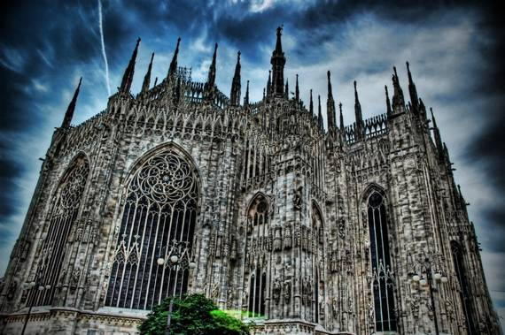
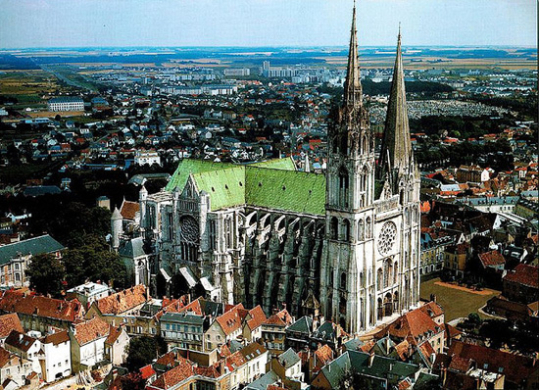
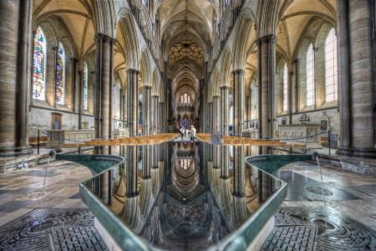

Slide 15
Assessment Question
Assessment question:
Write a paragraph explaining the many ways in which the Catholic Church was a dominating institution during the Middle Ages.

