Slide 1
Major Battles of the American Revolution

Slide 2
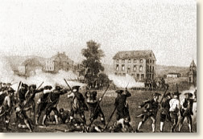
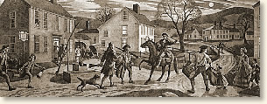
Lexington and Concord, April 19, 1775
The British chose to march to Concord because it was an arms depot.
British troops had occupied Boston and were marching on Concord as they passed through Lexington.
No one is still sure who fired first, but it was the "Shot Heard 'Round the World." Both sides opened fire, and the Americans were forced to withdraw.
But they had slowed the British advance. By the time the Redcoats got to Concord, the Americans were waiting for them in force.
The weapons depot was saved, and the British were forced to retreat, harassed by militiamen along the way.
The skirmishes were preceded by Paul Revere's famous ride, warning the countryside: "The British are Coming!"

Slide 3
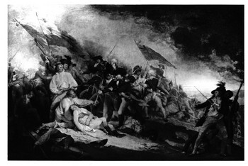
Battle of Bunker Hill June 17, 1775
Two-day engagement between British forces under the command of General William Howe and American forces under Colonel William Prescott.
The Americans had occupied Breed's Hill in Charlestown on June 16, 1775, in order to protect the shipyard of nearby Boston.
The next day, the British attacked. They took the hill but suffered heavy losses.
The Americans fired until they were out of ammunition, then quickly retreated.
To conserve ammunition, Prescott told his men, "Don't fire until you see the whites of their eyes." Even though the battle was fought on Breed's Hill, it has been remembered as the Battle of Bunker Hill.

Slide 4
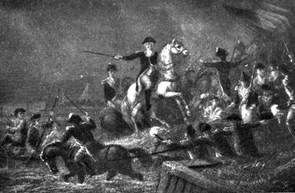
Battle of Brooklyn
First real battle between British and American forces, in August 1776.
Also called the Battle of Long Island.
Redcoats under Generals William Howe and Charles Cornwallis advanced on New York and tried to trap the Americans in Brooklyn.
General George Washington responded by holding his ground until nightfall and then retreating under cover of darkness.
The troop movements for this battle actually occurred over a number of days.
It was the first British victory and the first of many legendary Washingtonian escapes.

Slide 5
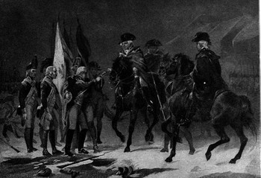
Trenton & Princeton
Famous American victory that began with "Washington Crossing the Delaware."
American army crossed the Delaware River, which was frozen in places, on Christmas night, 1776, from Pennsylvania to Trenton, New Jersey.
Americans surprised a drunken Hessian (Hired German Army) force that celebrated the holiday a little too much.
The battle lasted about 45 minutes and resulted in 900 Hessian prisoners.
January 3, 1777, following hard on the heels of General George Washington's great success at Trenton. The victory at Princeton drove the British out of New Jersey, almost for good.
They were smashing victories for the weary Americans, and they were also an opportunity to gain some badly needed guns and ammunition.

Slide 6
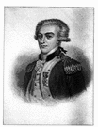
Lafayette
French officer who fought for America in the Revolutionary War. He participated in the Continental Congress and served under George Washington at the Battle of Brandywine and at Valley Forge. He also had a part in the final battle of the war, Yorktown

Slide 7
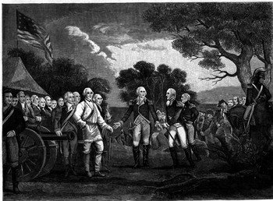
Saratoga
Turning point of the Revolutionary War: convinced France to enter the war on the side of the Americans.
British General Burgoyne came up with a brilliant plan to take all of New York. His three-pronged attack called for a meeting of three forces at Saratoga.
Burgoyne would advance south from Canada and plan to meet at Albany
St. Leger was to move east from Fort Oswego, on Lake Onratio;
Howe was to march north from Virginia.
It didn't work.
Howe never got the message and went to Philadelphia instead.
Burgoyne himself was stopped by American General Benedict Arnold at Saratoga.St.
Leger made it to Albany and had it all to himself.
At the Battle of Saratoga (which was really a handful of battles), Burgoyne surrendered almost his entire army to General Horatio Gates on October 17, 1777.
The American victory convinced France that America really did have a chance of winning. Soon thereafter, French money and supplies (and eventually, troops and ships) were making their way to America. The end had begun.

Slide 8
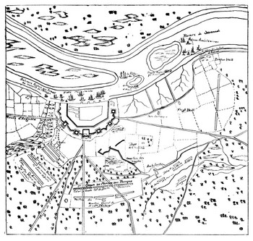
Savannah
Resounding British victory.
The British had seized Savannah a few months earlier.
A joint American-French forced tried to take back the city on October 9, 1779.
Commanding the American troops is General Benjamin Lincoln.
The casualties for the Americans and French were enormous
Notes:
What is the source? Who wrote it? Who’s perspective? What is it saying?
Who fired first?
- go through each of the documents.
Is your document truthful?
Rank the documents.
Which is the most reliable? Which document has a reason not to lie? (Emotional language)
Document number 3 is the most reliable because

Slide 9
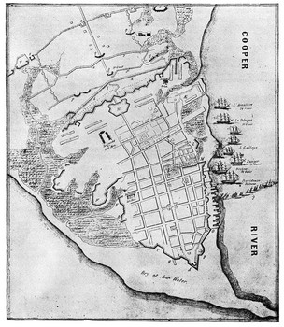
Charleston
British victory in the first few months of 1780 that gave Britain control of much of the Southern colonies.
Charleston was an important port and strategic center for the Southern Continental Army, nearly all of which surrendered at Charleston.
Under the command of General Benjamin Lincoln, the Americans held out as long as they could, then surrendered to the British, commanded by General Henry Clinton.

Slide 10
Yorktown
American victory that ended the Revolutionary War on October 20, 1781.
British General Charles Cornwallis had met defeat in the south, and his force had been continually weakened.
Cornwallis left the Carolinas and proceeded north to Yorktown, Virginia, there to await reinforcements from General Henry Clinton, who was occupied in the north.
American forces under Greene and Commander-in-Chief George Washington pursued Cornwallis by land while French ships surrounded the bay of Yorktown.
Faced with the prospect of no reinforcements, Cornwallis stood and fought. But the Americans won the battle and the war.

Slide 11
Surrender
At the surrender ceremony, Cornwallis's sword was accepted by General Benjamin Lincoln while a British band played "The World Turned Upside Down." This was the last major battle of the war, although some minor skirmishes took place for the next two years, until the Treaty of Paris ended the war in 1783.

Slide 12
BATTLE | STATE | VICTOR

