Slide 1
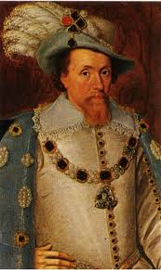
James I and his contribution to the English Civil War

Slide 2
Our squares of Revolution thus far
Political
Religious
Economic
Social
Parliament only called when king wants
Puritans are more influential in the houses
Witch hunt fever, unity against them
Trade and entrepreneurs changing face of social hierarchy and country landscape.

Slide 3
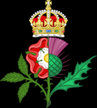
James I: “The Wisest Fool in Christendom”
King James had been ruling in Scotland as James VI.
When Queen Elizabeth, of the House of Tudors, died heirless, James (a cousin) inherited the throne of England.
When he took control of the English Throne, it effectively united the two kingdoms, though both Scotland and England continued to have their own parliament, legal courts, coinage, etc.

Slide 4
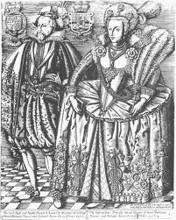
James I of England, James VI of Scotland
When he took over the English throne, he had been ruling in Scotland for over 20 years, with the help of four different regents when he was younger.
Under him, the “Golden Age” of literature and drama continued, and he himself was an avid writer.
He was a chaste king, growing up without the torrid love affairs that usually plagued a court. (There was a reason for that)
He eventually married Anne of Denmark. Together they had four children, the last of which, Charles would become the next king.

Slide 5
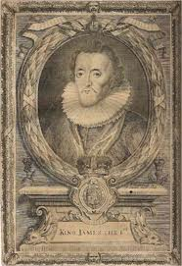
James’ travel to Denmark results in increase interest in witch hunts.
James went to Denmark to fetch his queen
Denmark was a country that was fiercely searching out and executing witches. Highly influenced by the “Witches Hammer”
He was delayed from returning to Scotland due to bad weather.
When he got back, he personally presided over the North Berwick witch trials. The women on trial there were accused of sending bad weather to impede James’ progress.
James became obsessed with witches and, inspired by his personal involvement, in 1597 wrote the Daemonologie, a manuscript which denounced witchcraft.

Slide 6
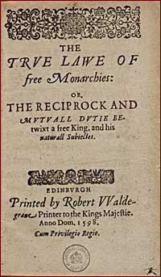
James I: the Divine Right of Kings
For all of James’ wisdom and education, he did some very silly things.
Prior to succeeding the English throne, he wrote a treatise introducing The True Law of Free Monarchies.
In the True Law, he sets out the divine right of kings, explaining that for Biblical reasons kings are higher beings than other men, though “the highest bench is the sliddriest to sit upon”
The document proposes that a king may impose new laws by royal prerogative but must also pay heed to tradition and to God, who would "stirre up such scourges as pleaseth him, for punishment of wicked kings“
Read Primary Source in text book – page 29

Slide 7
Results of the Divine Right of Kings
James stated in the True Law that a king owns his realm as a feudal lord owns his fief. Because kings arose
"before any estates or ranks of men, before any parliaments were holden, or laws made, and by them was the land distributed, which at first was wholly theirs. And so it follows of necessity that kings were the authors and makers of the laws, and not the laws of the kings.”
This attitude, that the king was above all others, other than God, and did not need the support of parliament was in violation of terms set out in the Magna Carta.
This high and mighty attitude of James would be passed down to his son, and cause more issues.

Slide 8
James I and the Catholic Church
When James ascended the throne in England, the Catholic church was excited. They thought that he would be less harsh on them than Elizabeth was.
Though he was protestant, at the start of his rule, he did away with fines for not attending Anglican service – but a little pressure from Parliament made him re-instate them.
Within a few years, James had done enough for a group of Roman Catholics to gather together and brew up a plot to explode the king and parliament.

Slide 9
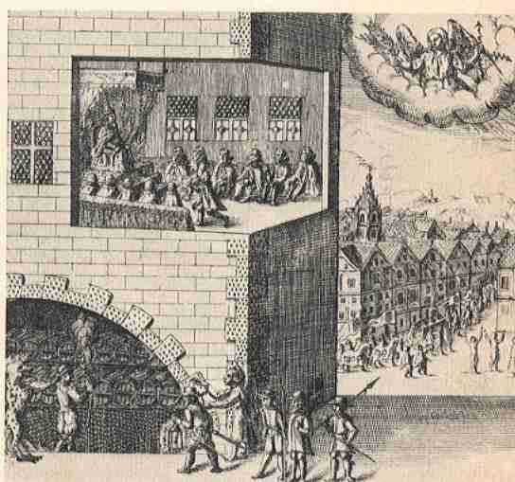
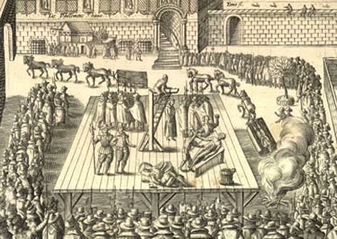
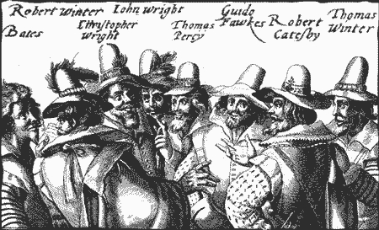
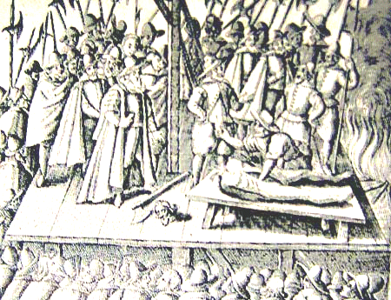
The Gun Powder Plot

Slide 10
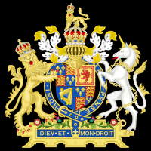
James I: life after the plot
While he should have used the event as an opportunity to unite with parliament – he pushed them away
He would call parliament for money – and then waste it. (He liked to party, and give money away to his Scottish drinking buddies)
He called no parliaments between 1614 and 1621, and effectively gave up trying to rule England.

Slide 11
Our squares of Revolution thus far
Political
Religious
Economic
Social
Parliament only called when king wants
Witch hunt fever, unity against them
Puritans are more influential in the houses
James doesn’t call parliament for 7 years
Divine right of Kings
Hates on for puritans, who happen to be the majority of parliament
King spending large amounts of money on frivolous things
Trade and entrepreneurs changing face of social hierarchy and country landscape.

Slide 12
James I: the end
He sowed the seeds for Irish civil unrest years later and missed out on the opportunity to unite all of the “United Kingdom” by giving plantations to Scots.
Much of his reign was lame, and set the stage for his 24 year old son to muck things up even more.
James’ son, Charles I, took the English throne in 1625, listed as the shortest king ever to rule Britain…even shorter once his head was chopped off.

