Slide 1
Regions of Canada
Crossroads: Chapter 6
Learning Intentions:
Understand what is meant by “region” in geographic terminology
Understand the mechanisms that create distinct geographic regions
Know the 4 characteristics that can define a geographic region

Slide 2
Introduction to Regional Geography
A) What is a Region?
1. A part of the world that is joined together by a t least 1 unifying characteristic
2. All regions have these 3 things: area, location, and boundaries
B) Types of regions:
1. Political
2. Geographic (physical features such as topography, climate, soils, vegetation)
3. Cultural (language, religion)
We will be studying the physical regions of Canada.

Slide 3
Introduction to Regional Geography
C) How do physical regions develop?
Plate tectonics
a. Plates of the Earth’s crust resulted from the breakup of Pangaea.
http://www.youtube.com/watch?v=ft-dP2D7QM4&feature=related
b. Plates move because of the composition of the earth. They move at the same rate as our finger nails grow!
c. The edges of these plates, where they move against each other, are sites of intense geologic activity, such as earthquakes, volcanoes, and mountain building. The Rocky Mountains, for example, are fold mountains that formed from layers of the crust being pushed together and crumpled over millions of years
d. See p. 161 of Crossroads for details & vocabulary.

Slide 4
Introduction to Regional Geography Continued…
2. Glaciation during the ice ages
Glaciation is a phenomenon in which massive ice sheets formed in the Arctic and Antarctic advanced toward, and retreated from, the Equator.
Glaciations were characterized by cool, wet climates and thick ice sheets extending from each pole.
When ice sheets began to melt at the end of the last ice age, about 12,000 years ago, some of the melt water became lakes; Lake Agassiz, for example, covered much of the southern prairies. The Canadian Shield was scraped by large ice sheets, leaving only a thin layer of soil. As glaciers retreat, the also leave debris in the form of hills
See p. 162 of Crossroads for an explanation of how glaciation affects landscapes.

Slide 5
Introduction to Regional Geography Continued…
These are renderings of what the Earth looked like during the last ice age
As you can see, Europe and North America are almost completely covered in ice.
Where would all the water come from to make these glaciers? What might happen to the
shape of the continents?

Slide 6
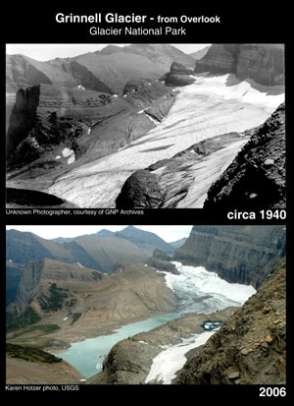
Introduction to Regional Geography Continued…
These are photos of Grinnell Glacier in Glacier National Park, Montana, USA
What do you notice between the 1940s photo and the one taken in 2006?

Slide 7
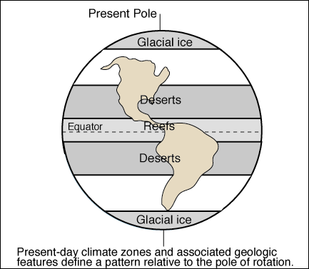
Introduction to Regional Geography Continued…
3. Climate
A region’s climate is determined by its relative location to the poles and/or the equator. Climate regions are typically warmer the closer they are to the equator, and colder the closer to the poles.

Slide 8
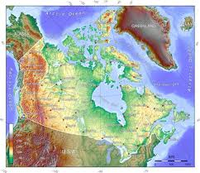
Introduction to Regional Geography Continued…
4. Topography
Refers to the shape of the land.
This is usually expressed in terms of elevation, slope, and orientation of physical features such as mountain ranges, rivers, valleys, plateaus, escarpments, tc.
See Crossroads p. 162

Slide 9
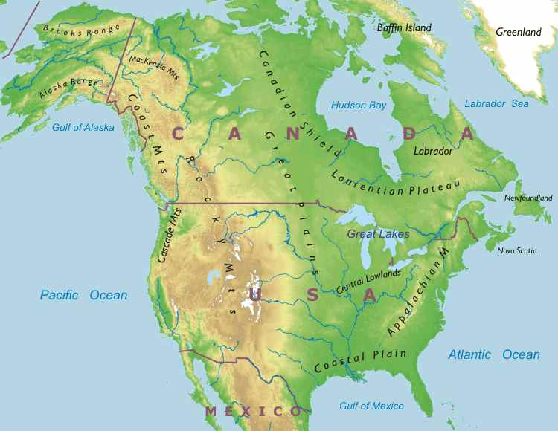
Physical Regions of Canada
Appalachian Region
Coastal Plains
Great Lakes-St. Lawrence Lowlands
Interior Plains
Canadian Shield
Western Cordillera
Intermountain Region
The Arctic

Slide 10
Classwork/Homework
Terminology
Complete the handout of vocabulary words using Chapter 6 of Crossroads.
Next Class – the regions of Canada in Depth and Climate graphs

