Slide 1
Other Grid Systems and Contour/Topographic Maps
AKA: how to figure out where something is and how high you have to climb
Learning Intentions:
Gain the ability to use 4 and 6 point grid systems to locate features on a map
Understand what the goal and purpose of a topographic map
Be able to create topographic profiles and contour maps

Slide 2
Other Grid Systems: Grid co-ordinates
When referring to the absolute location we can use a grid with co-ordinates to help us express its location precisely.
Often grids are laid out over a map to help us locate a destination or location.
Think about when you are looking up directions on a road map in the back of the book; it tells you the map page, and then a N/S grid number and a E/W grid number

Slide 3
Grid Systems
Knowing that grid systems are used to locate features on a map, understand that a grid is a series of lines dividing the map into squares.
We have learned about the Earth Grid system using lines of longitude and latitude
The four-figure reference system is often used for military maps, city maps, and maps of relatively local areas.

Slide 4
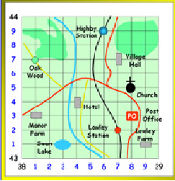
Four-figure reference system
Each square on the map is located on the map by referring to its southwest corner. Two lines cross here.
The number of the line running north-south is first.
The number of the line running east-west is written second.

Slide 5
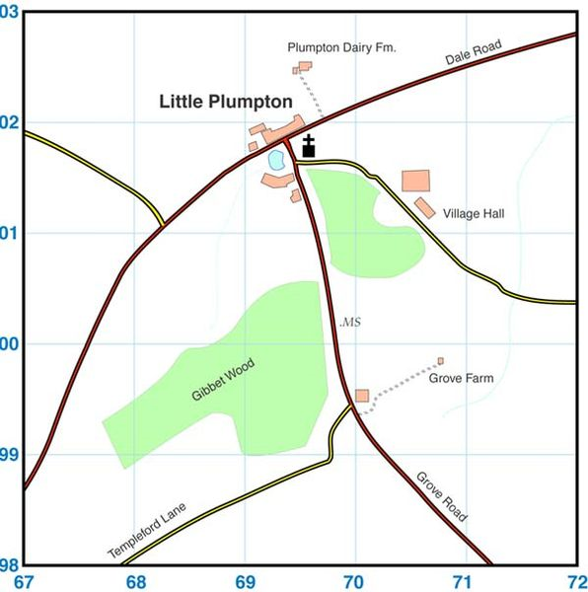
What are the co-ordinates for the church?
6901
What are the co-ordinates for Grove Farm?
7099
What are the co-ordinates for Little Plumpton?
6901 - 6902

Slide 6
Six-Figure reference system
As we saw with Little Plumpton and the church, their four-figure locations were the same; which is not overly accurate.
To be more precise, we can use a six-figure reference system.
This system adds in dividing numbers to each larger grid square. It is like looking at your ruler, seeing the centimeters and using the millimeters to be more precise.
BUT THERE ARE NO DECIMAL PLACES!

Slide 7
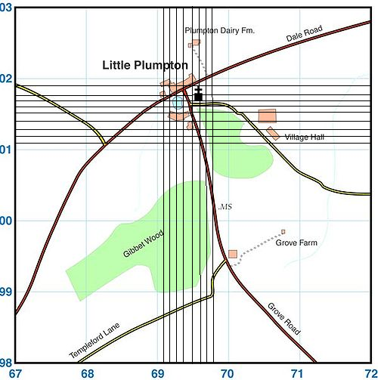
What is the six-figure reference for the church? Still read from the South-west corner, left to right, bottom to top 696019

Slide 8
Class work
Complete the handout “Grid Maps four and six points”
You have 10 minutes to work on this sheet.
Partners are allowed

Slide 9
Topographic Mapping
Recall that topographic maps show the height of land formations above sea level using contour lines
Please look at handout “GeoLab 11”
Volunteer to read section 1
Volunteer to read section 2
Section 3: Draw in the 100m contour line
Section 4: draw in the 500m contour line
Section 5: draw in the 400, 500, 600m lines
Section 6: draw in 25, 75, 100, and 125m keep the v shape in the contour lines

Slide 10
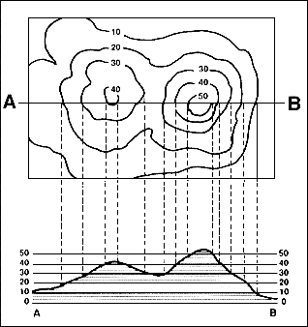
Topographic profile
A topographic profile is a cross sectional view along a line drawn through a portion of a topographic map. In other words, if you could slice through a portion of the earth, pull away one half, and look at it from the side, the surface would be a topographic profile.

Slide 11
Topographic profile
Turn to Hand Out “Topographic Profiles”
Together we will work though (a)
Label the distance between contour intervals
Use your ruler to draw descending lines from the contour lines from the overhead view to the corresponding contour line on the profile
Draw one line attaching all points on the profile
Complete (b) and (c) on your own

Slide 12
Classwork: on your own
GeoLab12
Complete questions 4 through 5
Do Not Do Questions 1,2,3,or 6
HOMEWORK:
Topographic Map of Vernon – to be marked next class

