Slide 1
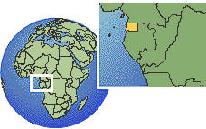
Maps and Mapping
Learning intentions:
Recognize the changes that have occurred in maps
Understand that maps serve different purposes
Be able to name some of the types of maps and map projections
Notes:
Do quick quiz on themes before lesson

Slide 2
Map Projections
Believe it or not, there have been several controversies over the representation of the Earth on world maps.
What could be the issue with some of the following maps?

Slide 3
T-O map – early map of the world that made the known world into a disc and placed Jerusalem at the center – Europe top Left corner, Africa Bottom Left, Asia on the right What does this map say to you? http://upload.wikimedia.org/wikipedia/commons/5/5b/Radkarte_MKL1888.png

Slide 4
What about this map from 1550? What inaccuracies can you find? http://www.floridahistory.com/us@1544.html

Slide 5
Map Projections
When we look at a map, it is a two dimensional representation of what the Earth looks like.
When making a map, a cartographer must represent the curved surface on a flat page, while minimizing distortion to preserve accuracy.
Things a cartographer must remember to preserve are:
Distance
Direction
Area
Shape
Proximity
What would be most important to you as a cartographer?

Slide 6
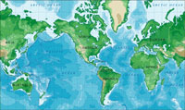
Types of projections
A cylindrical projection looks like this
Cylindrical projection maps, in which a cylinder which is wrapped around the Earth at the Equator, are often used for complete world maps. On a cylindrical projection map, the longitude and latitude lines are straight.

Slide 7
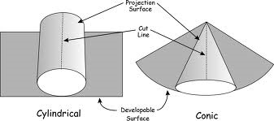
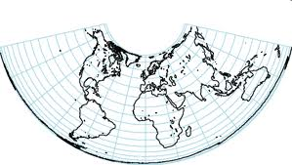
Types of Maps
Conical Map projections

Slide 8
An Oval Projection
The elliptical or oval projection, sacrifices accurate angles and shapes in favour of accurate area representations. It was first published by Karl Mollweide, a German astronomer and mathematician, in 1805. It is a pseudocylindrical projection which was designed to improve upon the cylindrical projection.

Slide 9
Planar projection
A planar projection is a map that results from the conceptual projection of the Earth onto a tangent or secant plane.
In other words it takes a cut of the earth from a top point of view and places on a circle like a cross section

Slide 10
Hobo-Dyer Map
From Wikipedia: The Hobo-Dyer map projection is a cylindrical equal-area projection. The cylinder is usually assumed to wrap around the globe and cut through the surface at 37.5° north and south. The Hobo-Dyer is often used with the south pole at the top of the map.^{[1]}
Taking a look at the next slide, who might like the Hobo-Dyer map?

Slide 11
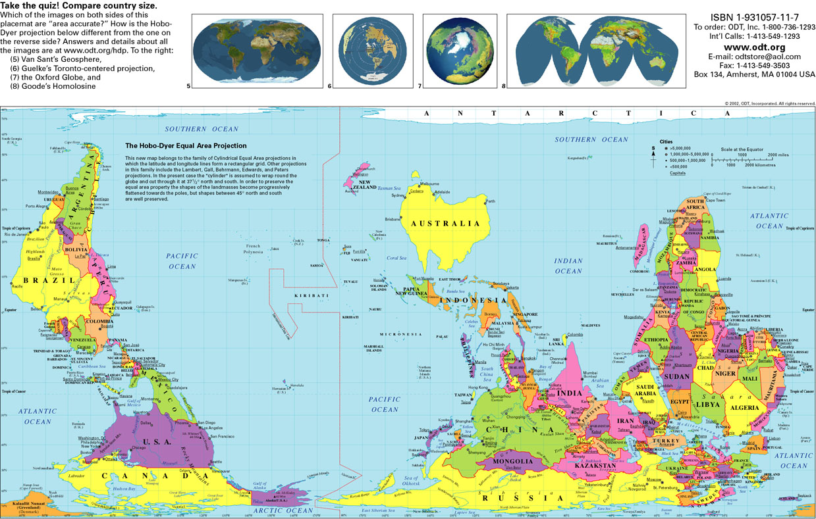

Slide 12
Review for classwork
REMEMBER!!
The Earth’s grid is a combination of lines of latitude (north and south degrees) and longitude (east and west degrees)
Using the grid, you can pinpoint the absolute location of places around the world
Notes:
Photo copy Earth grid work

Slide 13
Types of Maps
We are used to seeing Political or physical maps
However, there are maps that serve a variety of purposes
Can you name any other types of maps that you might have seen or used?
Here are some examples

Slide 14
Political Map: Shows boundaries, international boarders, and capitial cities

Slide 15
A physical map shows us: Land forms (mountains, lowlands, deserts, plains) Bodies of water (lake, rivers, ocean) The colours used on the map are the key to identifying the different physical features

Slide 16
A climate map shows us the average temperatures or precipitation in a region for a time of year: http://www.chinamaps.org/china/china-map-of-precipitation-annual.html

Slide 17
Topographical maps: show us through the use of contour lines the high or elevation of a region.
Topographic maps are important because they show how high land features are, and how steep the elevation gain is.
One reads the topographic map using contour lines. Contour lines are lines that represent equal gains of elevation on the ground

Slide 18
Scale
REMEMBER!!
Scale is used on maps to measure distance and area
There are 3 ways to show scale:
Graphic, verbal or statement, and representative fraction
A map showing a large area with very little detail uses a small scale
A map showing a small area with great detail uses a large scale
“small scale = big area
large scale = lots of detail”

Slide 19
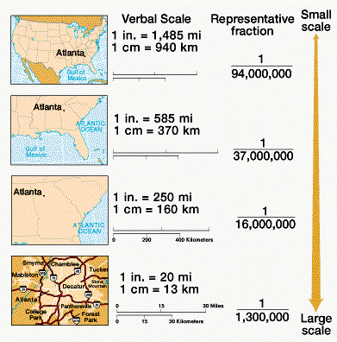

Slide 20
Class work
Complete GeoLab 5
Terms you need to have defined in your notes!
Lines of Latitude (aka Parallels)
Lines of Longitude (aka Meridians)
Notes:
Photocopy Earth grid, scale and map work sheets.

