Slide 1
Introduction to Geography
5 themes and general mapping skills
Learning Intentions for today:
Understand the five themes that the study of Geography addresses
Be able to use the Earth’s grid system
Know what elements are needed for an effective and complete map
Notes:
Review sheet on themes needs to be copied

Slide 2
What is Geography?
It is the study of the Earth’s surface and the interaction between humans and Earth
Geography comes from two Greek words: geo, meaning Earth and graphe, meaning “to write about”
Another way to define geography is this: a social science that deals with the description, distribution, and interaction of the diverse physical, biological, and cultural features of the Earth’s surface. [Merriam-Webster Dictionary]

Slide 3
What are the main ideas, or themes, in geography?
Five main themes:
Location
Place
Human-Environment interaction
Movement
Regions

Slide 4
Theme 1: Location
“Location, location, location”
Absolute location
Relative location
Site and place names

Slide 5
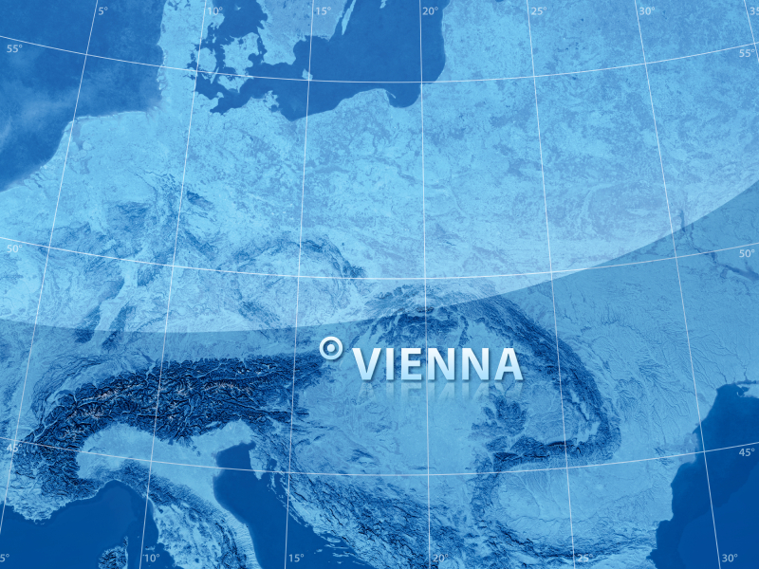
Absolute location
  Exact location of a place (kind of like your address)
  Absolute location uses lines of latitude and longitude to determine where something is.
    EG: absolute location of Vancouver BC is 49 degrees North, 123 degrees West

Slide 6
Lines of the Earth
Lines of Latitude
Lines of Longitude
Lines of Latitude or Parallels: imaginary lines (they aren’t actually on the surface of the Earth) that run East-West cutting the Earth into North and South Sections. So they measure distance north or south of the Equator
  0 degrees latitude is the Equator
  90 degrees N is North Pole, 90 degrees S would be... South Pole
  Tropic of Cancer 23.5 N Tropic Capricorn 23.5 S
  Arctic Circle 66.5 N Antarctic Circle 66.5 S
Lines of Longitude or Meridians: imaginary lines that run North-South and measure distance east or west of the prime or Greenwich meridian (0 degrees longitude)
  0 degrees is the Prime or Greenwich meridian that runs through London England
  180 degrees is the international dateline, running through the Pacific Ocean

Slide 7
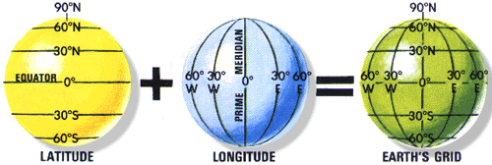

Slide 8
Relative location:
  Location of a place in relation to another
  - EG I am standing ____of the windows and ___of the mountains
  - EG Vancouver is West of Alberta and North of Washington
  - Share with your partner the relative location of the school to your house

Slide 9
Site and Place Name
Site and place names also describe location
  The site of a location is the physical character of the place
  Place names help identify a place. You can learn a lot about geography by studying names. What can you gleam from these names?
    Mont Saint Michael
    Moose Factory
    Head Smashed in Buffalo Jump
(Can you think of any other examples?)

Slide 10
Theme 2: Place
Place includes the physical and human characteristics of a location
Physical characteristics include features like lakes, rivers, hills or mountains, climate, soil, vegetation, height above or below sea level
Human characteristics include features that people have imposed, such as buildings, roads, bridges, signs.
While studying place geographers ask:
    What do I see?
    What does the land look like?
    What do the people look like?
    What sounds do I hear?
    (describe the place of Ambleside Beach or Collingwood School)
Notes:
Take a walk around to identify physical vs. human characteristics

Slide 11
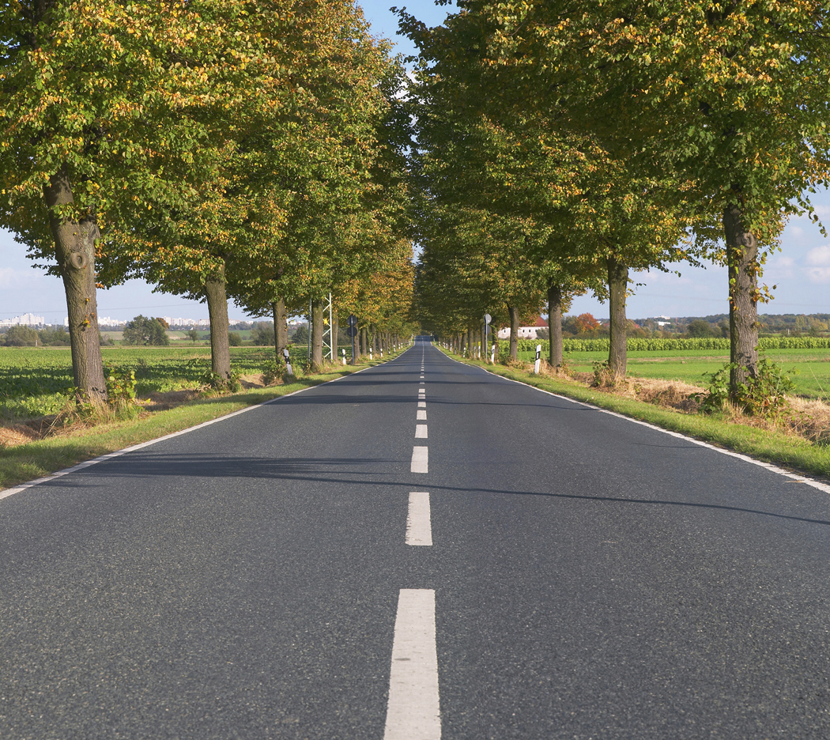
Theme 3: Human-Environment Interaction
Geographers are curious to know what influence the physical environment has on how people live and what humans do to influence the environment.
  Think about clothing, shelter, transportation
    How do we move around, dress, live in comparison to a desert? Arctic?
  Evidence of human-environment interactions include:
    Urbanization and suburbanization
    Environmental problems like acid rain
    Architecture of homes
    Placement of highways and infrastructure: examples?

Slide 12
Theme 4: Movement
People move around all the time and have done so since the beginning of human history. When people move, or migrate, they carry cultural features with them to new locations and are influenced by the new location itself.
People’s ideas move from place to place as well. Today, the movement of ideas is very rapid as a result of modern communication and technology. Belief systems, fashion trends, government, laws, bad jokes all move across the surface of the earth.
Products also move across the Earth
What examples of modes of transportation, cultural features, or products can you think of that move?
Share with your partner.

Slide 13
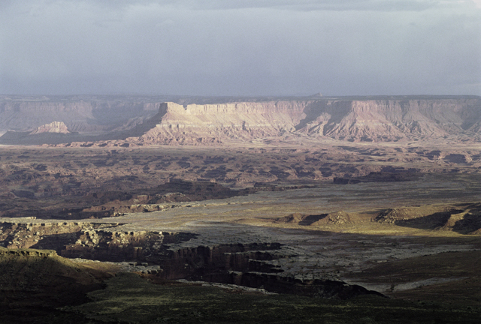
Theme 5: Region
A region is a part of the Earth’s surface that is joined together by at least one unifying characteristic.
Political Regions:
  British Columbia is a political region. Its unifying characteristic as a political region within Canada is that all the laws of the province apply throughout the region. Its boundaries are defined by law.
Physical Region:
  The Great Plains are a physical region, characterized by relatively flat, grassy land in the interior of North America.
Distinct Region:
  Quebec is a distinct region within Canada because the majority of its peoples speak French.
What would be the characteristic that unifies The North Shore as a region? What kind of region would it classified as?

Slide 14
REVIEW!
Complete the Five Themes of Geography Review sheet
You may use your notes if you need to
You have 3 minutes to complete before we move on
It will be corrected next class and homework marks will be given

Slide 15
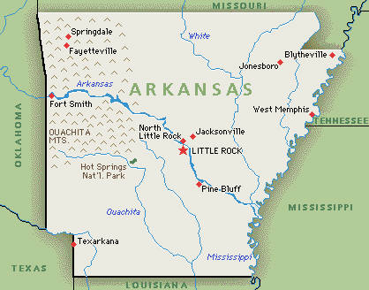
Maps and Mapping:
General Rules and Guidelines
Follow these rules and guidelines for maps, and your work will be accurate and excellent throughout the year!
Is the map below an example of a “good” map? Why?
What else is missing?

Slide 16
Mapping guidelines
Name: Print your name (first, last, block) in the top right-hand corner of the map
Title: The title should reflect the nature of the map – for example, physical, political, historical, religions, geographic map of…
Sometimes the title will be given to you; other times you will be expected to create an accurate title of your own.
Keys/Legend: a key or legend should only be used if it will be of value; generally if there is too much information to be put on a small map. A good map should show something at a glance; hence colour keys are often very helpful. The legend box should be placed on the bottom left-hand corner of the map, or in a place where there is enough room for it to fit and be legible. Colours should be harmonious; colouring should be light, shading using pencil crayon (NO MARKERS). This allows the reader to see all the printing on the map.

Slide 17
Mapping Guidelines
Symbols: Often maps have standardized symbols both for natural and human-made features
River:
Swamp/marsh
Extent of glaciations
City/village/town
Railway
Bridge
Check out page 4 in your atlas for other symbols
* Vancouver

Slide 18
Mapping Guidelines
Location: when placing items on a map, the location should be as accurate as possible. On a small world map, the thickness of a pen could equal hundreds of kilometres. If a city or a feature is located on the north side of a bay, place it there. With a long label, try to have part of the label on or near the feature (mountain ranges, along the range)

Slide 19
Mapping Guidelines
Printing: all map printing should be in pencil, unless instructed otherwise. It should be neat and legible. Sometimes it is good to vary the size of your label. CAPITAL CITY, Small City, Town
DO NOT: stack the letters in a label
DO NOT: use arrows to connect a label to a place
Cities: names of cities should be parallel to the base of the map. The name of the city follows a dot to indicate the exact location.
Rivers: Rivers should be printed along the line representing the river. The abbreviation for river is R.
Mountains: the name of a range should be printed along the path of the mountain range. ^^^ is the symbol for mountains. The abbreviation is MTS.
Lakes and bodies of water: these labels should be parallel to the bottom of the page.

Slide 20

Mapping Guidelines
Scale: scale shows the actual distances between places on the Earth’s surface. On a map it is shown 3 ways
Look at page 10, what is the scale?
How would you explain this as a statement?
* a statement of scale 1 cm = 1 km | * a linear or graphic scale | * a representative fraction 1: 100,000

Slide 21
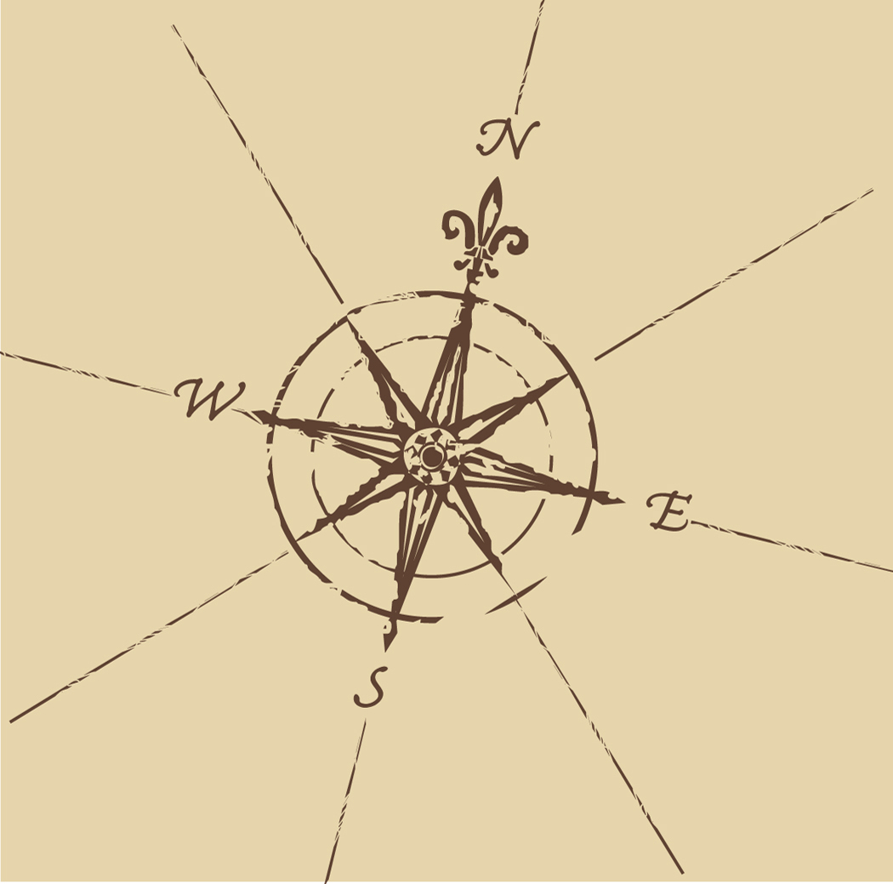
Mapping Guidelines
Borders: a good map will have borders drawn around its edges
Compass direction: unless indicated, the top of your map is north. Sometimes you may be asked to indicate north by using a north arrow or a compass rose.

Slide 22
Homework
Review the Themes of Geography
Complete and review your worksheet on using the atlas
Label your map of Canada with the Provinces
Be prepared to be quizzed on this next class
Notes:
rev

