Slide 1
The Radical Stage of the Revolution
Political Parties and the People who led them

Slide 2
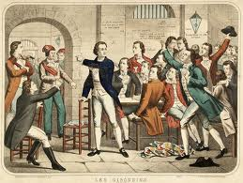
The Political Clubs
There were no parties in France at this period in history. People joined political clubs.
Clubs held meetings, published pamphlets.
Two important clubs were the Girondists and the Jacobins. Both began as moderate, but they became embroiled in conflict over their ideals. The Girondists lost.

Slide 3
At first, they wanted sweeping changes in government; but people began to see them as too conservative.
Sent to the guillotine
Main speaker
Brissot
Girondists
Radical
Responsible for the Reign of Terror
Leaders
Robespierre
Danton
Marat
Jacobins

Slide 4
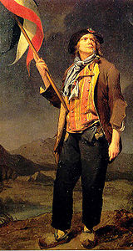
The Sans-Culottes
Remember that the Third Estate had been comprised of a very wide range of people – from very wealthy to very poor.
Inevitably this group of French citizens would disagree about what changes they wanted in France.
The Sans-Culottes were mostly poor people from Paris who wanted lower prices and food for the people.
They resented the bourgeoisie and were violent.
They thought the Girondists were too moderate.
They supported the Jacobins.
Wanted to execute the king and aristocrats.
Led by the angry newspaper man, Jean-Paul Marat

Slide 5
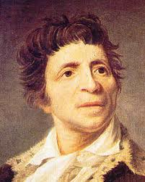
Leaders of the Radical Jacobins
Jean Paul Marat
Editor of L’ami du Peuple
He was a strong supporter of the Sans Culottes
A very angry man.
He contracted a skin disease while hiding in the sewers
Spent much time in his bath
Was murdered by Charlotte Corday in his bath
Was a martyr for the revolution
The Death of Marat,
Jacques-Louis David

Slide 6
Leaders of the Jacobins
Maximilien Robespierre
A passionate and skilled orator
Called the “Incorruptible”
Opposed the war against Austria
Originally against the death penalty
Then used it well in removing his enemies, including the king
Instrumental in the Committee of Public Safety, who instituted the Reign of Terror
“ To punish the oppressors of humanity is clemency; to forgive them is barbarity. ” — Maximilien Robespierre, 1794

Slide 7
Leaders of the Revolution
Jacques Danton
Leader of the Mountain
Leader in the National Assembly
First President of the Committee of Public Safety.
His speeches and actions were not always approved of by Robespierre
He eventually supported the end of the Political executions ~ which lead to his own.
“Boldness, more boldness, boldness, forever boldness, and the motherland is saved.”
“A revolution cannot be made with Rosewater”

Slide 8
Revolutionary Wars
Early on in the revolution, many aristocrats fled the country to try and re-establish the old regime from outside of France. They were called Émigrés.
Meanwhile, inside of France, radical revolutionaries (Marat, Danton, Robespierre) seized the opportunity of possible external invasion to unite the country and speak passionately in favor of the revolution.
France fought Austria in 1972, winning against them.
The people of France were determined to have a new government, and the radicals had strong influence.

Slide 9
The End of the Monarchy
France became suspicious of the Royal family as they continued to fight other European countries.
Perhaps they were encouraging these attacks?
The Royal family had been forced to move to Paris, tried to escape, was caught, and brought back.
A newly elected group, the National Convention, with Robespierre, decided that the Revolution would not succeed while the King was still alive.
They put him on trial for crimes against his own country.
Does this remind you of anything?

Slide 10
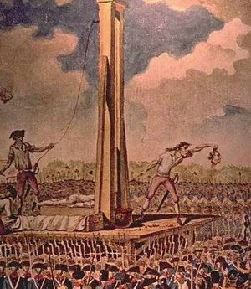
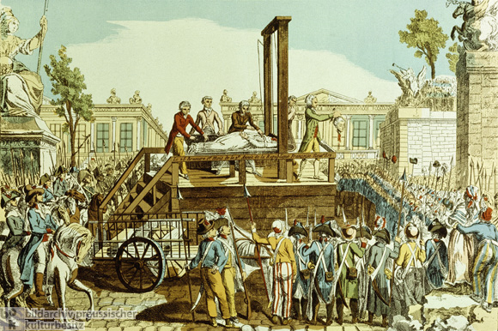
The End of the Monarchy
Louis Capet (Louis XVI) was tried, found guilty, and guillotined in January 1793.
Mary Antoinette was tried, found guilty, and guillotined in October 1793

Slide 11
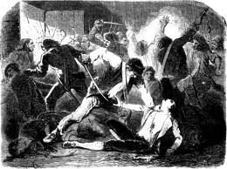
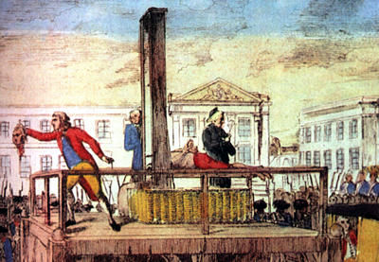
The Reign of Terror
The Jacobins and Sans-Culottes were now in charge of the revolution. Many Girondists were arrested and imprisoned as they were considered enemies of the revolutions.
The years 1793-1794 are know as the Reign of Terror. At this time the revolutionary government had sweeping powers. It passed laws to create fear and eliminate anyone who disagreed with the Jacobins.
The Law of Suspects: anyone of noble family or who held office before the revolution could be arrested
Being unable to show a birth certificate of citizenship would lead to immediate arrest and execution
Armed forces are reorganized
New regulations regarding business
Food speculators were guillotined
All granaries and bakeries under state control

Slide 12
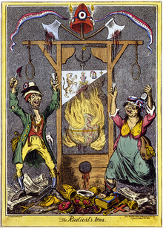
The Reign of Terror
During the Reign of Terror, about 37,000 people were guillotined, including Danton.
After Danton’s death, Robespierre ruled France as dictator.
He got rid of all political opposition and made many changes in France
Metric system
New Revolutionary Calendar
Efficient army
New schools and universities
Confiscation of land belonging to émigrés

Slide 13
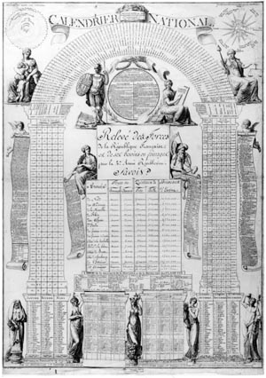
The New Calendar
12 months
Year 1 starts 1792
Months according to seasons
Months are three weeks of 10 days each
It goes against Christian beliefs because there is no longer a Sunday to worship.
Check out page 85 Crossroads to see the new months.

Slide 14
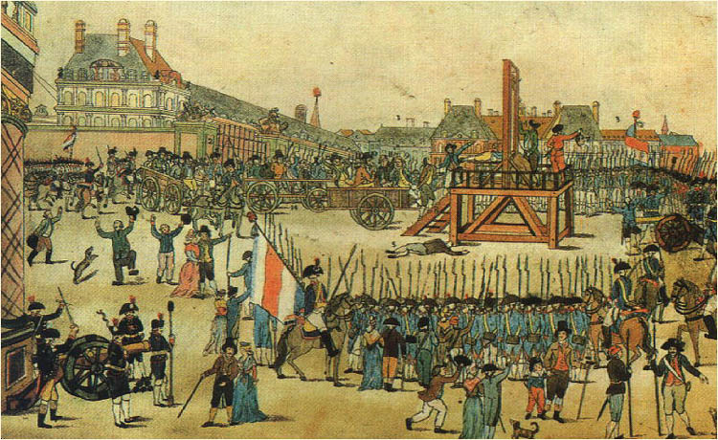
The Reign of Terror
Robespierre instilled fear in the people; as he tried to condemn more and more people, he himself was condemned.
He was arrested (shot himself in the jaw)and guillotined.
Upon his death, the Reign was over.
Radical Jacobins were replaced by the Thermodoreans, who wanted to bring peace to the revolution.

Slide 15
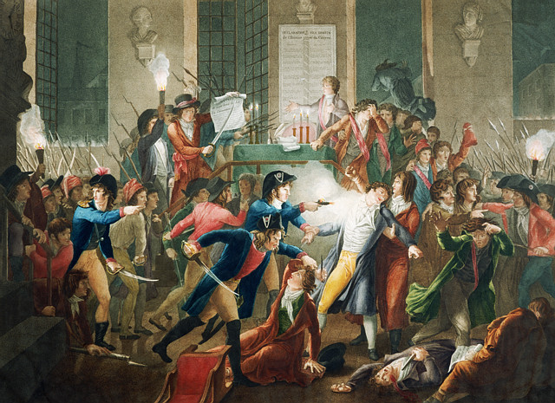
Fulchran Jean Harriet & Jean Joseph François Tassaert, La Nuit du 9 au 10 thermidor an II, Arrestation de Robespierre

Slide 16
The Directory
When Robespierre was removed as dictator, the middle class ruled France under the Directory.
The new government put the power to vote and elect members to government into the hands of those who owned property
This meant a return to special privileges for people with money
Many advances made by the poor during the revolution were gone, and equality was no longer protected (but was it really under Robespierre?)
Soon, the Directory, too, would be replaced by the leadership of Napoleon Bonaparte.

