Slide 1
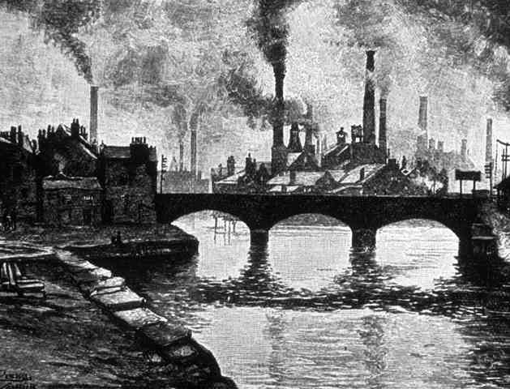
Cottage Industry to Factory age
The Industrial Revolution:

Slide 2
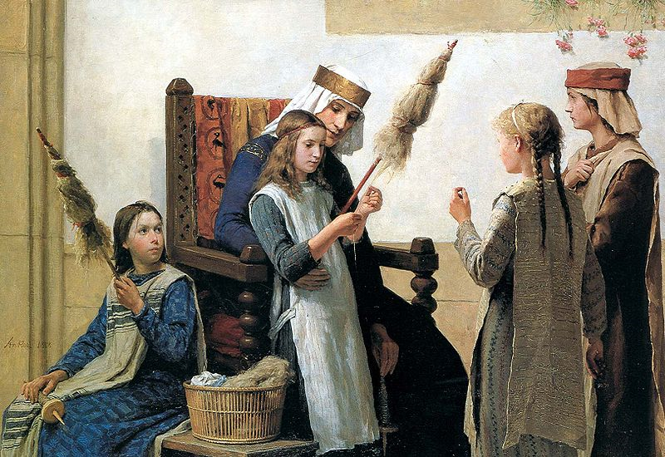
Cottages to Factories
Prior to the revolution, most products were made by hand in the home; this was the cottage industry, or the domestic system.
In the cottage industry, capitalists paid people to make product in their own homes.
People were paid for piecework
Making textiles was an example of cottage industry.
Clothiers paid people who were also farmers to spin or weave.
Clothiers then sold the finished goods

Slide 3
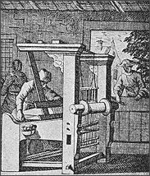
Advantages & Disadvantages
Advantages
Work at home
Supplement income
Look after families
Lived and worked in their own community
Disadvantages
Spinners and weavers were poorly paid
Long hours
Cottages worked alone, thus had little bargaining power when dealing with employers

Slide 4
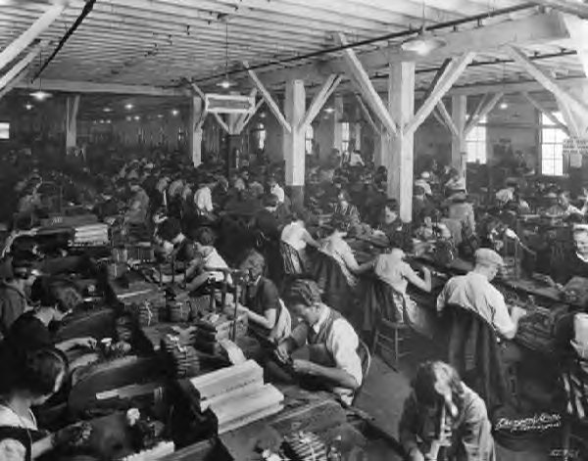
Why did the cottage system disappear?
New inventions needed a source of energy- water or steam, that cottages could not supply
Machinery is large and heavy, too big for a home.
Factories changed how people lived
Factory system attracted thousands and thousands of workers
Created new cities
Made Britain very wealthy
All parts of production can happen under one roof (why is that important?)

Slide 5
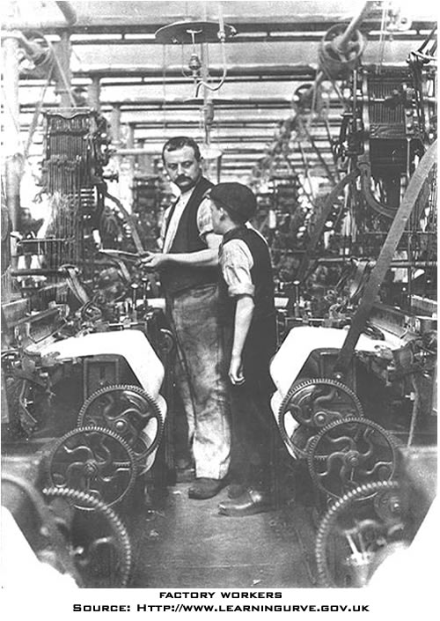
Working Conditions; Factory life
For working people, living and working conditions were very bad
Factories: noisy, dangerous, dirty
Owners: motivated by profit and competition. Cared little for workers (low wages, terrible conditions)
http://youtu.be/zF_U4VGl1Jk (work terrible work)
Child labour
No laws protecting them against harsh conditions
Income was essential for families (school not compulsory)
Long hours and little pay
Their small size was useful in factories
Exposure to unsanitary and unhealthy conditions
http://www.youtube.com/watch?v=3GuuTD0i2jU (victorian claims direct)

Slide 6
Factory Acts
Social reformers tried to improve these living and working conditions by putting pressure on government and factory owners.
This took a long time because politicians and factory owners were reluctant to make changes that might damage the economy.
Eventually, enough members of parliament were appalled by what they learned about factory life and living conditions they passed the factory acts.
Reduction in the number of hours children could work
Age limits on child workers
Workers’ associations (early labour unions) were legalized by1824.
http://www.youtube.com/watch?v=hHdXXwv3f3Y (Victorian Eastenders)

Slide 7
Industrial Revolution Movie
Answer the questions:
What is an industrial revolution?
What were the characteristics of Britain prior to the Revolution?
What conditions made Britain ready and best suited to having an industrial revolution?
What two industries drove the revolution?
Where did factory towns appear? What happened to people‘s living habits?
What was the average work hours/week?
Why were factories called “dark satanic mills?”

Slide 8
Movie Questions
Why were the workers paid so little?
How did steam change the face of the revolution?
How did Dicken’s and Marx’s writings respond to the industrial revolution?

Slide 9
Homework
Before leaving: What three-five words now summarize your opinion and understanding of the industrial revolution?
Read pages 130-134
Answer/complete the handout

