Slide 1
Roots of Civil War
England in the Early Modern Era
1600-1700

Slide 2
Foundations of Modern society
Things we can thank England for as Canadians
Tea
Monty Python
Democracy and civil rights
Magna Carta, 1215
Signed by King John (the one from Robin Hood)
Recognized individual freedoms and required the king to consult an elected parliament, and to rule lawfully.

Slide 3
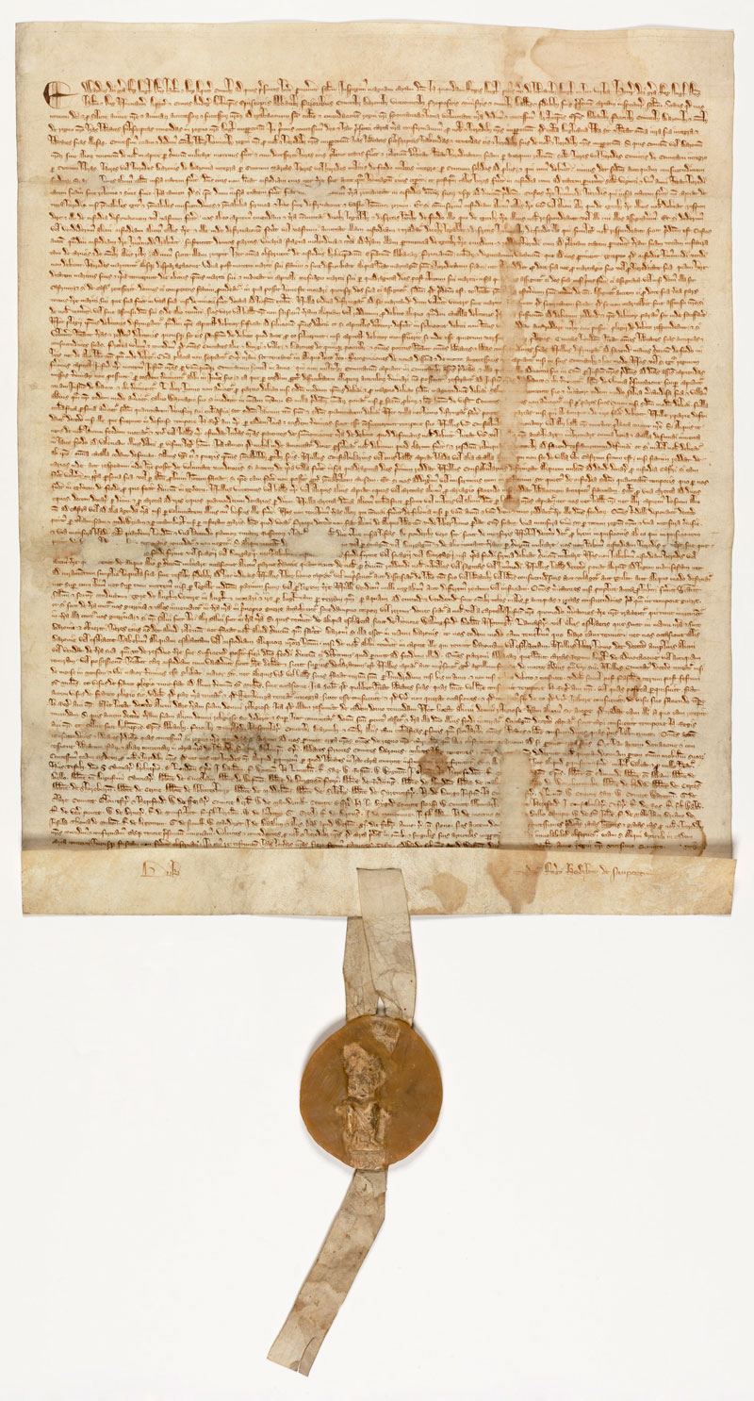
The Magna Carta
Magna Carta was written by a group of 13th-century barons to protect their rights and property against a tyrannical king. It is concerned with many practical matters and specific grievances relevant to the feudal system under which they lived. The interests of the common man were hardly apparent in the minds of the men who brokered the agreement. But there are two principles expressed in Magna Carta that resonate to this day:
"No freeman shall be taken, imprisoned, disseised, outlawed, banished, or in any way destroyed, nor will We proceed against or prosecute him, except by the lawful judgment of his peers and by the law of the land."
"To no one will We sell, to no one will We deny or delay, right or justice."

Slide 4
Monarchs and Parliament
Most British monarchs accepted parliament and looked to it for advice on policy.
The Tudors (Henry VII, Henry VIII, Mary, Elizabeth) accepted the democratic traditions that had been gained and kept parliament on their side.
The Tudors ruled as individual dictators, with counsellors and advisors
However, they needed the English establishment on their side, and Parliament ensured that every part of Britain was represented in a debating chamber which the monarch had summon if they wanted to say, increase taxes for a new war.
New laws had to be exacted by noblemen who were part of parliament, as they were essentially mini-monarchs in their own region.

Slide 5
The Relationship between Monarchs and Parliament
There were two sections to Parliament; the Commons and the House of Lords.
Parliaments did not sit often, and monarchs called Parliament for mostly one reason – Money.
You could liken the relationship between Parliament and the Monarch to parents and a child gone off to university

Slide 6
English Society
What was English society like in the 1600s?
Rapid increase in wealth due to trade and control of the seas.
Colonization increasing
Population growth; growing numbers of entrepreneurs, merchants, manufacturers, and landholders = more opportunities for wealth.
Deep divisions between classes.
Uppers (king, nobles, high church officials)
Middles (merchants, professionals, officers. Could move upwards)
Lowers (workers, farmers, unemployed)
Complete the Chart on English Society

Slide 7
Class | Occupation | Information regarding occupations | Housing and furnishing | diet
Upper Class | King, king’s advisors, nobles, high church officials |  | Fine city and town homes, filled with valuable possessions | Meat, cheese, anything they wanted
Middle Class | Merchants, manufacturers, landowners, professionals, Military officers |  | Country homes | Meat, cheese
Lower Class | Skilled workers – carpenters, blacksmiths, stone masons, dress makers, ordinary workers | Belong to guilds Work long hours little pay | Small cramped | Bread and beer
Below lower class | Widows, children, unemployed |  | Often no housing | Bread and beer

Slide 8
Religions and England
Recall the events surrounding The Tudor monarchy and the church
Henry broke from the Roman Catholic church so as to divorce Queen Catherine of Aragon and marry Anne Boleyn.
Martin Luther had made his stand and started the Protestant movement.
While Henry was around, the church in England was “under construction”.
When Henry’s son King Edward took the throne, England was declared to be Protestant.
When Edward died and Queen Mary took over, the country returned to Catholicism (Bloody Mary anyone?)
When Mary died, Elizabeth returned the country to the Protestant church.

Slide 9
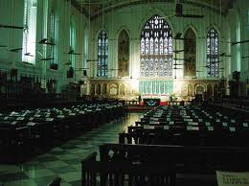
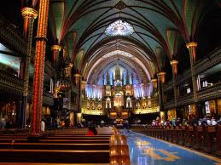
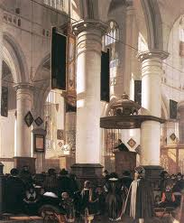
Religion and England
The 1600s roll around, most of England is Protestant, some are still Roman Catholic, but there are other communities as well with growing numbers.
Complete the chart about the various religious groups in England

Slide 10
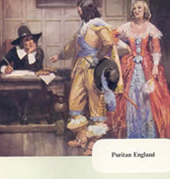
Religion | Definition | Aspects of the religion
Protestant | Any Christian not belonging to the Roman Catholic or Eastern Orthodox Church
Church of England (Anglican) | The established church in England, headed by the monarch | Supported by taxes Services and ceremonies were elaborate and buildings richly decorated. Service in English
Puritans and Calvinists | A follower of the teachings of John Calvin, a leader of the Protestant reformation | Opposed ceremonies and decorations of the Anglican church; service should be simple Wore dark clothes and led sober lives; no drinking, gambling, theater – life is devotion to God. Strict laws are needed to keep people from sinning.

Slide 11
Religion and England
A certain amount of tolerance was given towards the dissenting Puritans.
They could have services, as long as they occasionally went to Anglican services.
Though at other times, it was illegal to practice and they were imprisoned.
Many Puritans fled England to practice their beliefs freely (Mayflower to the Americas – Plymouth Rock, the first Thanksgiving)
Others entered into politics, using this venue to advance their cause. Creating conflict with the monarchs in power, both on religious and political grounds.

Slide 12
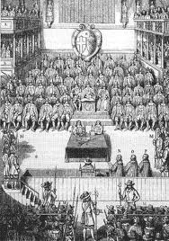
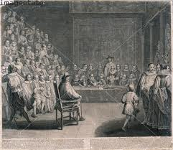
Religion and England
The tensions created by the puritans in parliament and the monarch of the day (James I and more specifically Charles I) would prove to be a spark for the British civil war.

