Slide 1
Events in the 13 Colonies that led to the Revolution
LEARNING INTENTIONS
Understanding the following events contributed to the anti-British Sentiment American Revolution
Stamp Act, 1765
Boston Massacre, 1770
The Tea Act, 1773
Boston Tea Party, 1773
The Intolerable Acts, 1774

Slide 2
Introductory Notes #1
Americans
Spirit of liberty
Local self government
Influenced by enlightenment
England & colonies
Relationship based on imperialism
Army there to protect colonists from native attacks
Part of their mercantile system

Slide 3
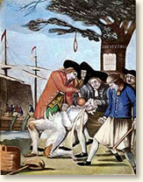
Introductory Notes #2
Post Seven years war
England trying to recover debt
Parliament wants colonies to help pay off debt
Imposes taxes on various British Imports
13 Colonies are hostile to these taxes, they don’t buy imports.
“NO TAXATION WITHOUT REPRESENTATION”
Parliament removes all taxes, except on tea

Slide 4
Introductory Notes #3
Americans
More freedom to rule themselves than any of other country’s colonies
Own legislature: governor’s council and elected assembly, with power to pass most tax laws
Colonies control their own local governments
Town meetings, pick police, judges, jury members
Religious freedom grew
Were there for a better life; to live out the Enlightenment ideals; life, liberty, and property

Slide 5
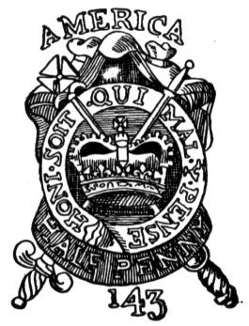
The Stamp Act, 1765
A small tax, like a Good and Services Tax on many goods and some government services.
Tax was in the form of a stamp that people had to buy and stick on everything
It was supposed to pay for the cost of defending the American colonies
Americans were angered because they had no say in their taxation, no representation in Britain.

Slide 6
King George III
An Act for granting and applying certain Stamp Duties (taxes), and other Duties, in the British Colonies and Plantations in America, towards further defraying the Expenses of defending, protecting, and securing the same; and for amending such Parts of the several Acts of Parliament relation to the Trade and Revenues of the said Colonies and Plantations, as direct the Manner of determining and recovering the Penalties and Forfeitures therein mentioned.
In other words; a tax to pay for defending the colonies.

Slide 7
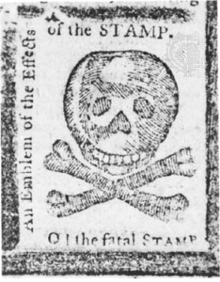
Stamp Act; reactions
Officers sent to enforce the tax were often attacked, tarred and feathered
Houses of government officials were destroyed
Protests and lawlessness scared English Parliament
Many politicians and English people, sided with the Americans.
Few officials were brave enough to enforce the tax.
It was removed and taken away in 1766

Slide 8
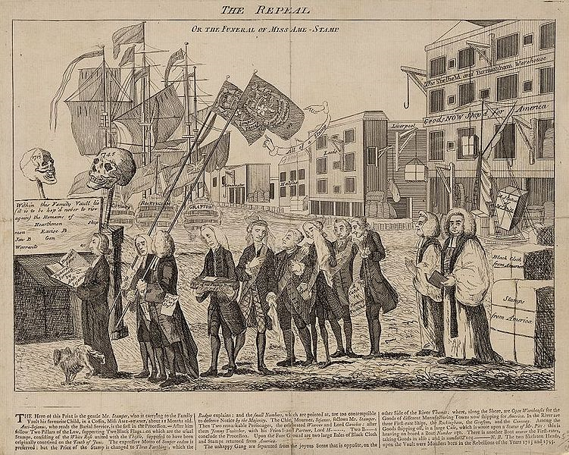
This cartoon depicts the repeal of the Stamp Act as a funeral, with Grenville carrying a child's coffin marked "born 1765, died 1766".

Slide 9
The Sons of Liberty
It was during this time of street demonstrations that locally organized groups started to merge into an inter-colonial organization of a type not previously seen in the colonies.
Although the term "sons of liberty" had been used in a generic fashion well before 1765, it was only around February 1766 that its influence as an organized group, using the formal name "Sons of Liberty", extended throughout the colonies, leading to the development of a pattern for future resistance to the British that would carry the colonies towards 1776.
While the officers and leaders of the Sons of Liberty “were drawn almost entirely from the middle and upper ranks of colonial society,” they recognized the need to expand their power base to include "the whole of political society, involving all of its social or economic subdivisions." To do this, the Sons of Liberty relied on large public demonstrations to expand their base.
They learned early on that controlling such crowds was problematical, although they strived to control "the possible violence of extra-legal gatherings." While the organization professed its loyalty to both local and British established government, possible military action as a defensive measure was always part of their considerations.
Throughout the Stamp Act Crisis, the Sons of Liberty professed continued loyalty to the King because they maintained a "fundamental confidence" in the expectation that Parliament would do the right thing and repeal the tax

Slide 10
Boston Massacre, 1770
Britain was making more moves that angered the Colonists.
Restrictions on business and trade
Housing soldiers and paying for their lodging
The British increase in troops in Boston led to a tense situation that erupted into brawls between soldiers and civilians.
A mob of protesters gathered on King Street (ironic, and now known as State street), Boston, in front of a sentry who stood on guard at the customs house.
Initially it was a small group that grew to over 400 people.
Insults and rocks were thrown at the sentry and another officer, the crowd grew and grew.
The British soldiers showed restraint, until Private Montgomery was struck down onto the ground by a club wielded by Richard Holmes, a local tavern keeper. When he recovered, he fired his musket, later admitting to one of his defense attorneys that he had yelled "Damn you, fire!“
It is presumed that Captain Preston would not have told the soldiers to fire, as he was standing in front of the guns, between his men and the crowd of protesters. However, the protesters in the crowd were taunting the soldiers by yelling "Fire“.

Slide 11
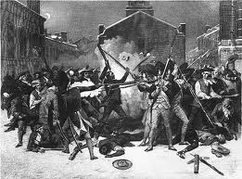
Boston Massacre, 1770
There was a pause of indefinite length; the soldiers then fired into the crowd. 13 men died (11 on the scene and 2 later from their wounds)
To keep the peace, the next day royal authorities agreed to remove all troops from the centre of town to a fort on Castle Island in Boston Harbor. On March 27 the soldiers, Captain Preston and four men who were in the Customs House and alleged to have fired shots, were indicted for murder.

Slide 12
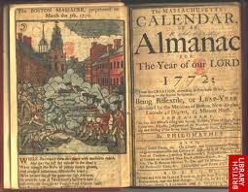
Boston Massacre, 1770
The Boston Massacre is considered one of most important events that turned colonial sentiment against King George III and British acts and taxes. These events followed a pattern of Britain asserting its control, and the colonists' chafing under the increased regulation.
It demonstrated how British authority galvanized colonial opposition and protest.

Slide 13
The Tea Act, 1773
In May of 1773 the British Parliament gave the struggling East India Company a monopoly on the importation of tea to America.
Additionally, Parliament reduced the duty the colonies would have to pay for the imported tea.
The Americans would now get their tea at a cheaper price than ever before. However, if the colonies paid the duty tax on the imported tea they would be acknowledging Parliament's right to tax them.
Tea was a staple of colonial life - it was assumed that the colonists would rather pay the tax than deny themselves the pleasure of a cup of tea.
American colonists saw this law as yet another means of "taxation without representation" because they couldn't buy tea from anyone else (including other colonial merchants) without spending a lot more money.
This was the situation in Boston that led to the Boston Tea Party.

Slide 14
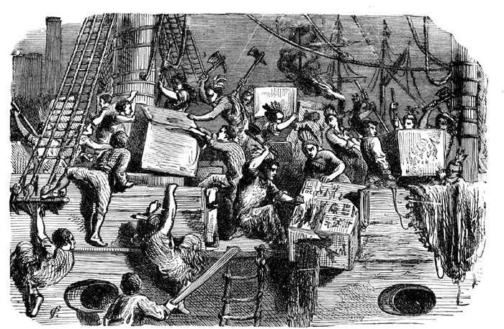
Boston Tea Party
In reaction to the Tea Act,
Members of the Sons of Liberty disguised themselves as Native Americans (Mohawks), climbed on to 3 ships and dumped 45 tons of tea into the harbor.
Leader of the Sons of Liberty, Samuel Adams, argued that the Tea Party was not the act of a lawless mob, but was instead a principled protest and the only remaining option the people had to defend their constitutional rights.

Slide 15
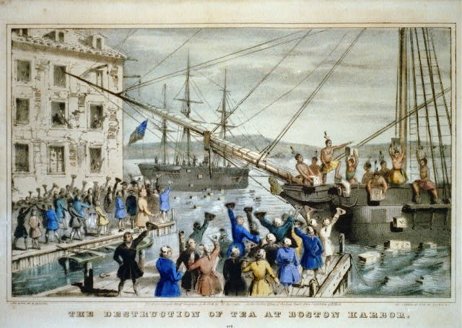

Slide 16
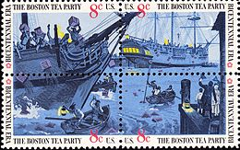
Boston Tea Party
In Britain, even those politicians considered friends of the colonies were appalled and this act united all parties there against the colonies. The Prime Minister Lord North said, "Whatever may be the consequence, we must risk something; if we do not, all is over".
The British government felt this action could not remain unpunished, and responded by closing the port of Boston and putting in place other laws known as the "Coercive Acts"

Slide 17
The Intolerable Acts / The Coercive Acts
The Intolerable Acts or the Coercive Acts are names used to describe a series of laws passed by the British Parliament in 1774.
Four of the acts were a response to the Boston Tea Party; the British Parliament hoped these punitive measures would, make an example of Massachusetts, reverse the trend of colonial resistance to parliamentary authority that had begun with the 1765 Stamp Act.
A fifth act, the Quebec Act, enlarged the boundaries of what was then the Province of Quebec and instituted reforms generally favorable to the French Catholic inhabitants of the region.
Colonists viewed the acts as a violation of their rights, and in 1774 they organized the First Continental Congress to coordinate a protest.

Slide 18
Intolerable / Coercive Acts
The Boston Port Act, the first of the acts passed in response to the Boston Tea Party, closed the port of Boston until the East India Company had been repaid for the destroyed tea and until the king was satisfied that order had been restored. Colonists objected that the Port Act punished all of Boston rather than just the individuals who had destroyed the tea.
The Massachusetts Government Act provoked even more outrage than the Port Act because it unilaterally altered the government of Massachusetts to bring it under control of the British government. Under the Government Act, almost all positions in the colonial government were to be appointed by the governor or the king. The act also severely limited the activities of town meetings in Massachusetts to one meeting a year, unless the Governor calls for one. Colonists outside Massachusetts feared that their governments could now also be changed by the legislative fiat of Parliament.

Slide 19
Intolerable / Coercive Acts
The Administration of Justice Act allowed the governor to move trials of accused royal officials to another colony or even to Great Britain if he believed the official could not get a fair trial in Massachusetts. Although the act stipulated that witnesses would be paid for their travel expenses, in practice few colonists could afford to leave their work and cross the ocean to testify in a trial.
The Quartering Act applied to all of the colonies, and sought to create a more effective method of housing British troops in America. In a previous act, the colonies had been required to provide housing for soldiers, but colonial legislatures had been uncooperative in doing so. The new Quartering Act allowed a governor to house soldiers in other buildings if suitable quarters were not provided

Slide 20
Intolerable / Coercive Acts
The Quebec Act was a piece of legislation unrelated to Boston, and so is not always regarded as one of the Coercive Acts. The timing of its passage led colonists to believe that it was part of the program to punish them.
The act enlarged the boundaries of what was then the Province of Quebec and instituted reforms generally favorable to the French Catholic inhabitants of the region, although denying them an elected legislative assembly.
The act removed references to the Protestant faith in the oath of allegiance, and guaranteed free practice of the Roman Catholic faith.
The Quebec Act offended a variety of interest groups in the British colonies.
Land speculators and settlers objected to the transfer of western lands previously claimed by the colonies to a non-representative government.
Many feared the establishment of Catholicism in Quebec, and that the French Canadians were being courted to help oppress British Americans.

