Slide 1
Actions leading to the American Revolution
How British rule and actions in Canada helped push the Americans to the edge.

Slide 2
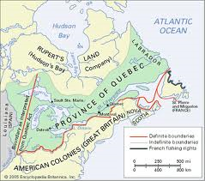
Learning intentions
Critical Terminology
Actions in Canada
Quebec’s fall leads to angry Americans
A Royal Proclamation
Quebec Act

Slide 3
Terminology
New Englanders
The term given to the settlers of the 13 Colonies
United Empire Loyalist (Loyalists)
One who is faithful, or loyal, to Britain
Land speculator
One who buys and sells land with the expectation of profit
Land claim
Legal claim to one’s original territory

Slide 4
How events in Canada effected the New Englanders: Quebec the Conquered
Fall of Quebec – surrendered to British 1759
Treaty of Paris – 1763
Stops fighting between Britain and France for control of N.A.
France gives control of all Canadian properties (except Louisiana to Spain) to England.
Quebec now under English control
Rule through military rule
Language and culture continue on
Fair business interactions

Slide 5
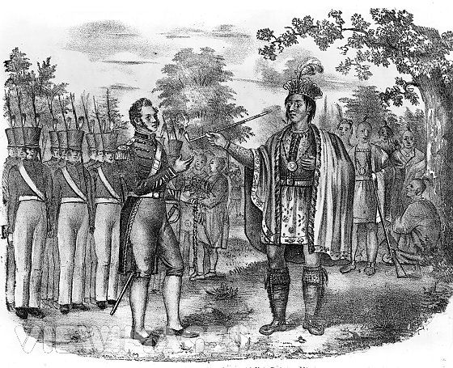
How events in Canada effected the New Englanders: Native Resistance
Resistance to changes in trading alliances
Traders and land speculators a threat to their way of life
Pontiac tries to unite Aboriginals to fight the British.
Pontiac may not have been able to defeat the British, but his actions drew the attention of King George of England.

Slide 6
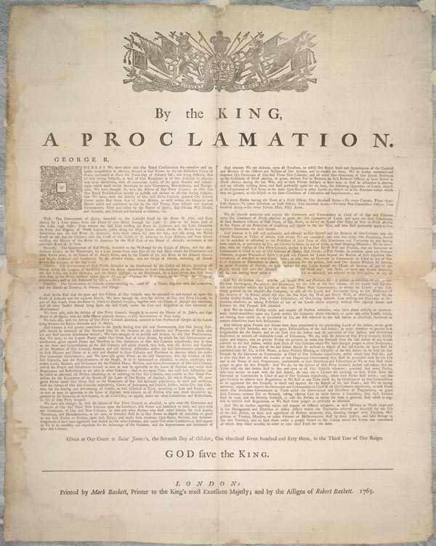
How events in England & Canada affected the New Englanders: A Royal Proclamation
1763 – George announces that land west of the Appalachian Mountains (Ohio Valley and West) were not open for speculation, those who were there are ordered out.
13 Colony colonist are stuck, Natives keep their land and control entry.
This makes the Anglo-Americans mad!!!
Britain seems more interested in what was good for them, and not their colonists.
Anglo-Americans felt like second class citizens

Slide 7
THE ROYAL PROCLAMATION, 1763
"WHEREAS we have taken into Our Royal Consideration the extensive and valuable Acquisitions in America, secured to our Crown by the late Definitive Treaty of Peace, concluded at Paris the 10th Day of February last; and being desirous that all Our loving Subjects, as well of our Kingdom as of our Colonies in America, may avail themselves with all convenient Speed, of the great Benefits and Advantages which must accrue therefrom to their Commerce, Manufactures, and Navigation, We have thought fit, with the Advice of our Privy Council, to issue this our Royal Proclamation, hereby to publish and declare to all our loving Subjects, that we have, with the Advice of our Said Privy Council, granted our Letters Patent, under our Great Seal of Great Britain, to erect, within the Countries and Islands ceded and confirmed to Us by the said Treaty, Four distinct and separate Governments, styled and called by the names of Quebec, East Florida, West Florida and Grenada, and limited and bounded as follows, viz.
First — The Government of Quebec bounded on the Labrador Coast by the River St. John, and from thence by a Line drawn from the Head of that River through the Lake St. John, to the South end of the Lake Nipissing; from whence the said Line, crossing the River St. Lawrence, and the Lake Champlain, in 45 Degrees of North Latitude, passes along the High Lands which divide the Rivers that empty themselves into the said River St. Lawrence from those which fall into the Sea; and also along the North Coast of the Baye des Châleurs, and the Coast of the Gulph of St. Lawrence to Cape Rosières, and from thence crossing the Mouth of the River St. Lawrence by the West End of the Island of Anticosti, terminates at the aforesaid River of St. John, etc. etc. etc. Given at our Court at St. James's the 7th Day of October 1763, in the Third Year of our Reign. God Save the King

Slide 8
How events in Canada affected the New Englanders: The Quebec Act
1774 – Quebec Act changes Quebec to a British Colony (not just land under military rule)
The act was good for the French population and Canada, but Americans had issues with it
Importance of Catholic Church
French Law for business and personal law
Introduced English Criminal Law
Quebec’s borders bigger to the west
Secret and unknown to the Canadiennes, the Quebec Act contained instructions for repression of the church and English civil law. But, they were never carried out.

Slide 10
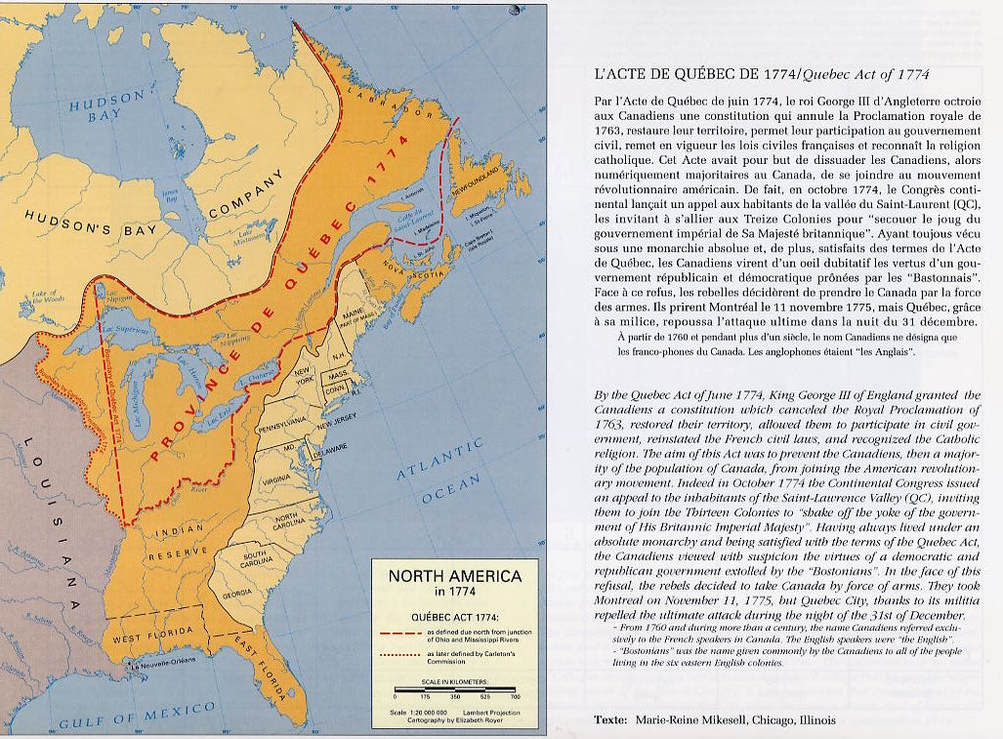

Slide 11
A comparison of land: Can we see why the Americans might be mad?
Size of Quebec in 1763
Size of Quebec in 1774

Slide 12
How events in Canada affected the New Englanders: Quebec Act – Two Views
For Quebec
For Americans
It seemed to respect rights
Retained old seigniorial system and feudal rights
Habitants were disappointed
They wanted an elected assembly like the 13 Colonies
Keep language and other traditions
Same system, different King
Designed to keep them loyal to Britain
Breaking point for Americans
Want to expand to the Ohio Valley but can’t – but Quebec has access
The lack of elected assembly for Quebec was a bad sign that they would not be getting more democracy as they wished.
Quebec Act was intolerable

Slide 13
How did events in Canada affect the Americans?
Placing limits on land speculation and expansion
Too much self-interest on Britain’s part in dealing with Native Americans
Not enough willingness to give democratic rights.
The Quebec Act – an Intolerable Act

Slide 14
A TIME LINE OF EVENTS
Royal Proclamation, 1763
Stamp Act, 1765
Boston Massacre, 1770
The Tea Act, 1773
Boston Tea Party, 1773
The Intolerable Acts, 1774
The Quebec Act, 1774
First Continental Congress, 1774
Second Continental Congress, 1775
Declaration of Independence, 1776

