Slide 1
His Royal Highness, King Louis XIV and XVI
How their actions helped fuel the Revolution

Slide 2
Louis XIV – The Sun King
“Etat c’est moi” ~ I am the nation.

Slide 3
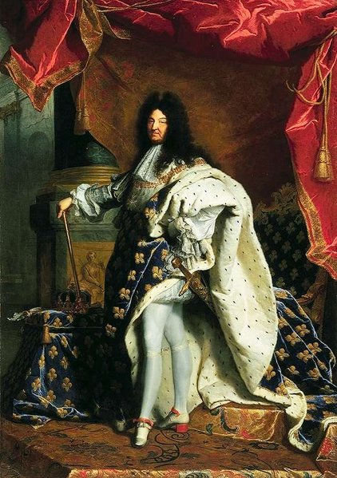
Louis XIV – extravagant and elegant
Ruled France for 72 years as an ABSOLUTE monarch
Believed the country, its culture and life, revolved around him.
Built the palace of Versailles and forced important nobles to live with him there (to ensure life did revolve around him)
Everything required his approval and one wanted to be in his favor (royal awakening anyone?)
Louis relied upon his own judgment (with a few external assistants) to rule. His word was law.

Slide 4
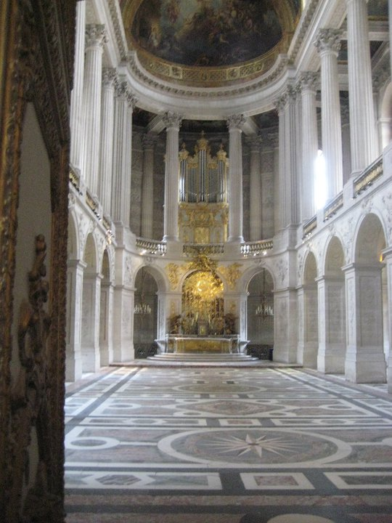
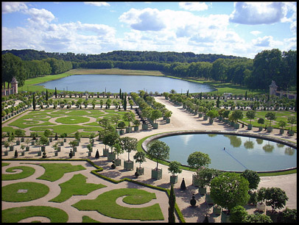
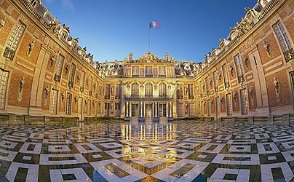
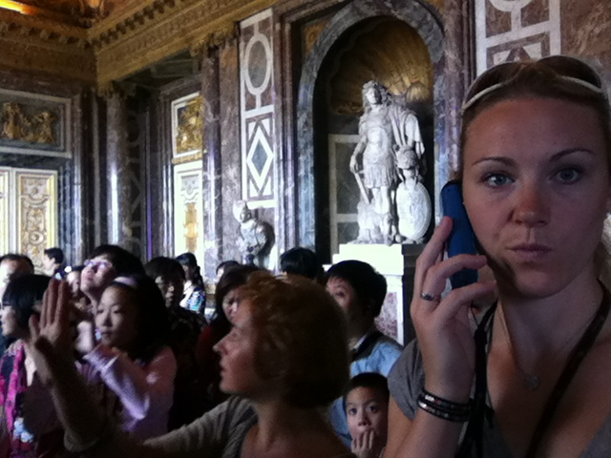
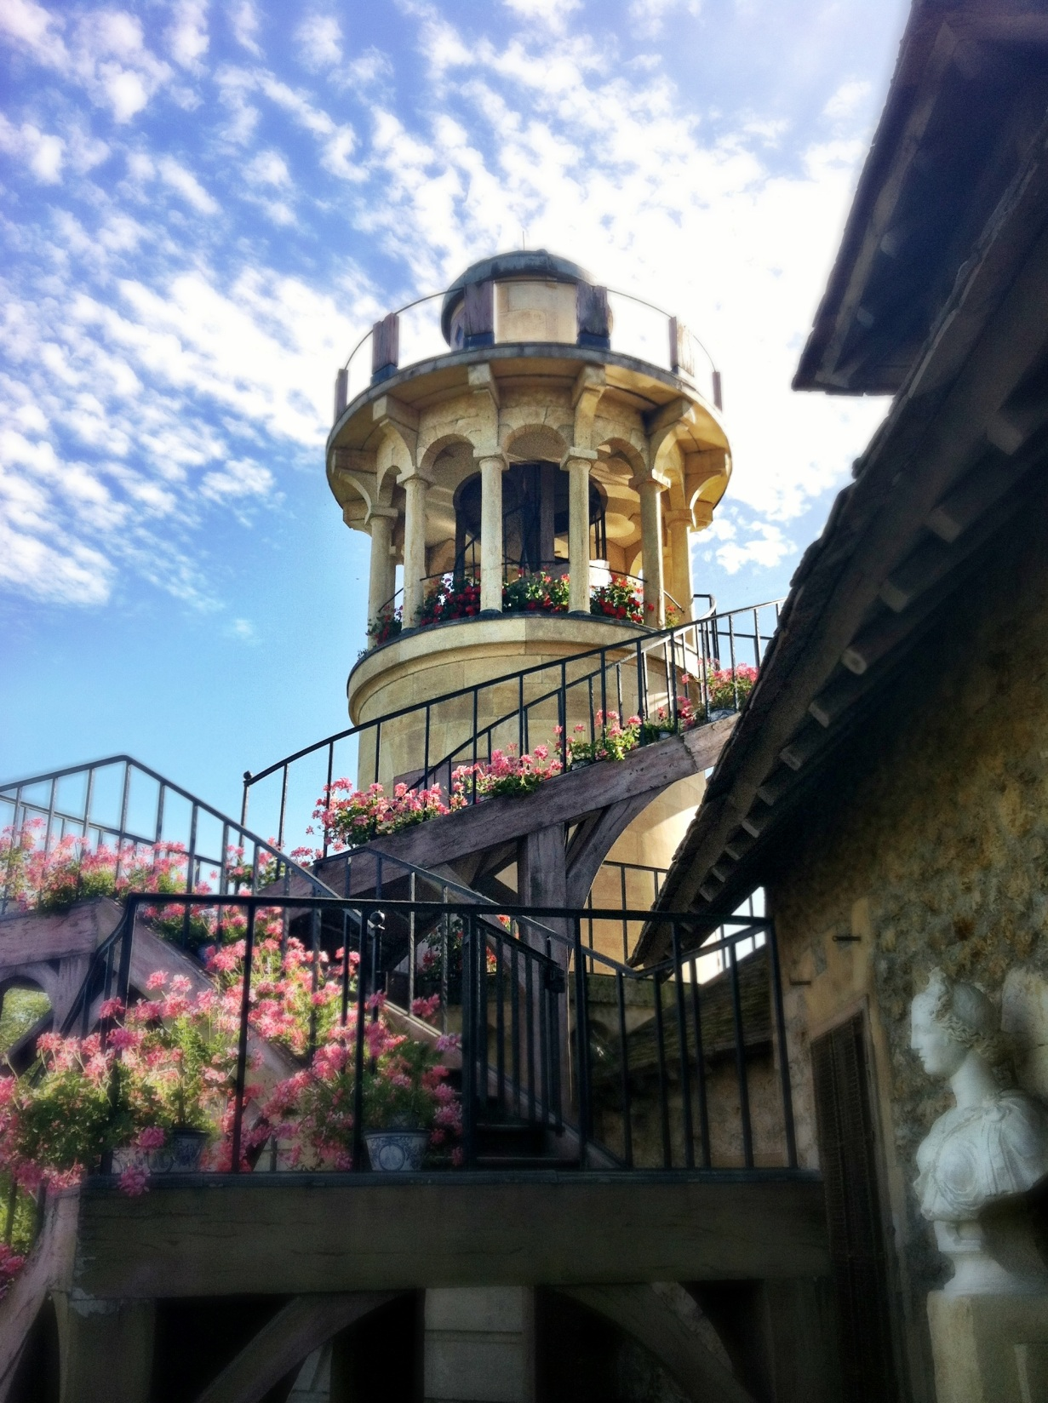
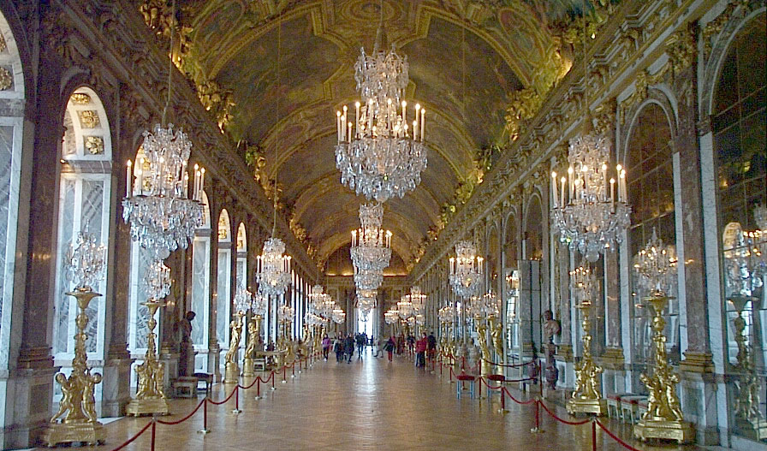
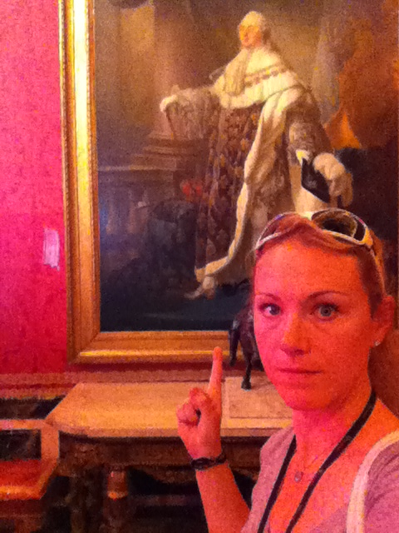
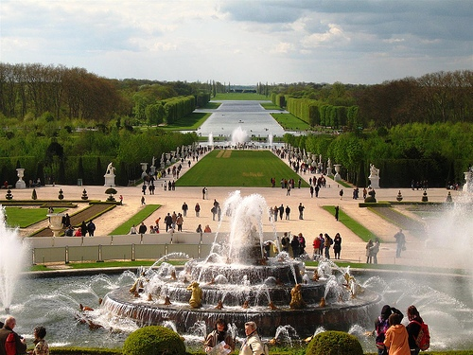
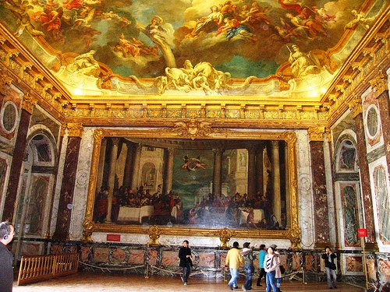
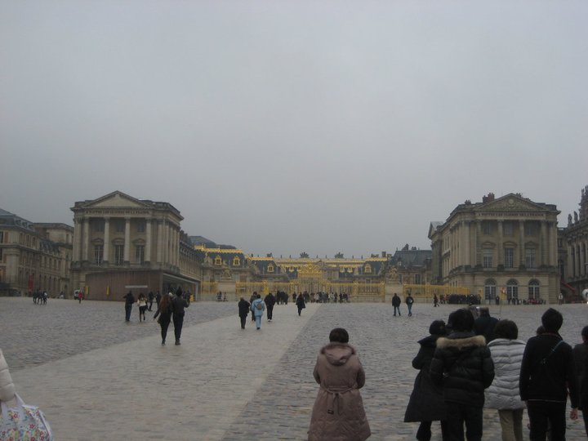
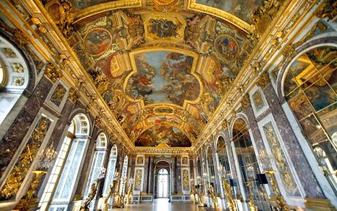
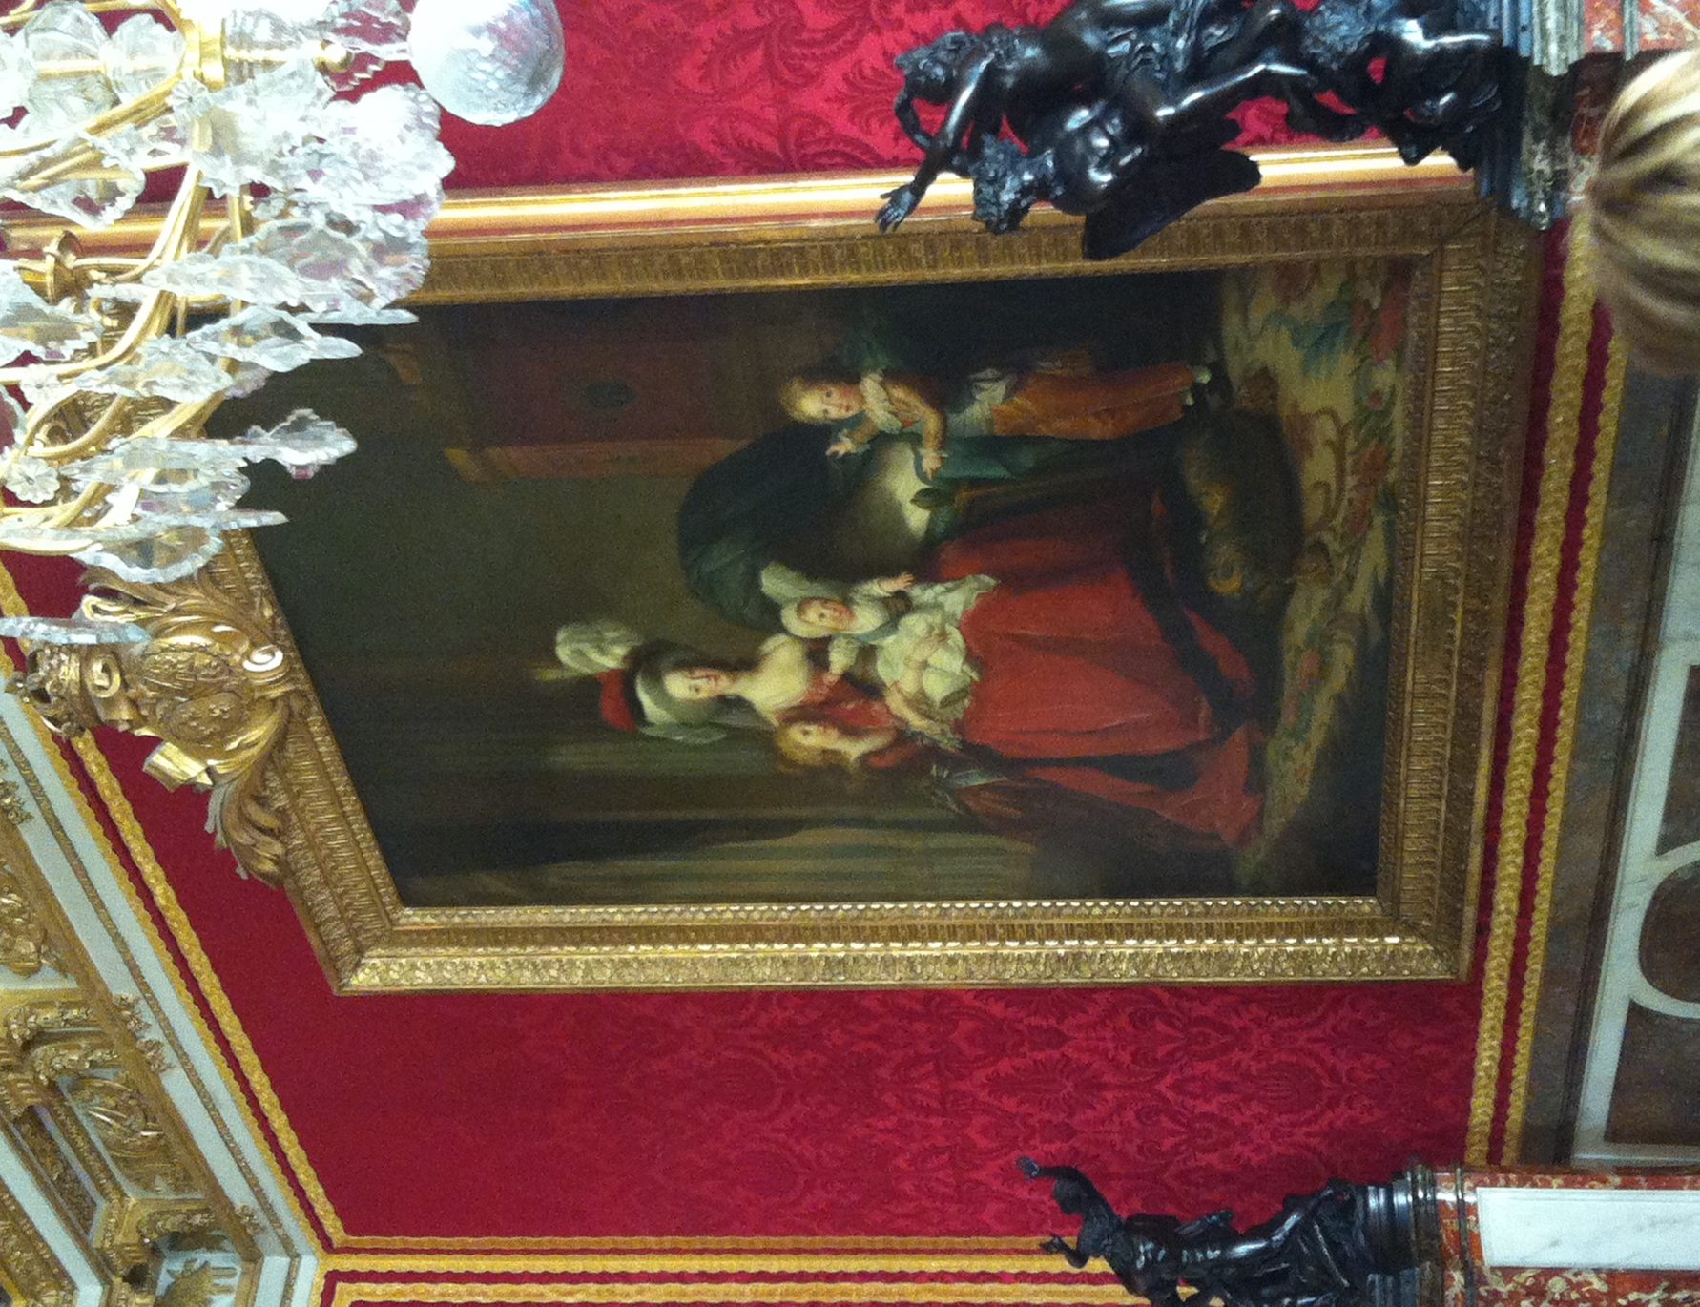

Slide 5
Louis XIV – great at Palace design, not so great at balancing the budget…
Trying to expand French territory, he had a number of unsuccessful wars.
Fighting with the Dutch in the 1660’s gained some territory, but depleted the treasury
Involved with the politics of the Catholic Church; he prosecuted so many protestants there was a huge decline in population in pockets across the country (exile of the Huguenots)
During Louis XIV’s reign, the deficit was twice the government’s revenues.
When his grandson Louis VX came to the throne at age 5, court extravagances continued and failure to reform social and economic problems continued to push the country towards disaster.

Slide 6
Louis XV
Grandson of Louis XIV
Inherited the throne at the age of 5
Fights the losing battle in the 7 years war

Slide 7
Louis XVI : Inheriting a mess
What I should like most is to be loved.
~ Louis XVI

Slide 8
Louis XVI – The Sun King’s (Louis XIV) Great-Great Grandson
Louis XVI was not a strong king, a lout and 20 years old when he inherits the throne
He was weak willed, easily swayed, indecisive, leaving most governmental decisions to others..
He had good intentions, he had no interaction or understanding of the lower classes.
The problems facing France were too great for one man alone to face them.
The middle class did not support him, because they could not understand why he was not trying to improve the country’s conditions.

Slide 9
Louis, and his Austrian born wife, Marie-Antoinette lived in the Palace of Versailles, continuing their ridiculous and extravagant living.

Slide 10
King Louis – extravagant? Or just your average French King?
Looking at the decadence of Versailles, what questions or comments come to mind?
How would you feel if you were a peasant and you happened to see Versailles?
Read the excerpt from page 202, written by Madame Roland – how is this a balanced view of the King? Does it sway your opinion on him?

Slide 11
Marie Antoinette
A lady in the wrong country at the wrong time

Slide 12
Marie Antoinette
At the age of 14 she married Louis XVI
A member of the Austrian royal family, the connection was hoped to solidify relationships between the two countries.
The French people hated her from the get-go.
She was well intertwined with the glamorous court life, but she fancied herself more modern and offended aristocrats by dismissing tradition French manners.
Her husband was more interested in food than consummating their wedding.
She did not endear herself to the people
She had a play farm
She spent hordes of money on jewels
She gave uneducated opinions about ministers and advisors
And fired those who would curtail her spending!

Slide 13
Marie Antoinette and Children ~ Vigee LeBrun, 1788
What do you notice about the Queen and her family?
What expression does she wear on her face?

Slide 14
Class/ Homework
Complete the interview questions and review questions for the Louis’
Read over Crossroads 192-194 and 202-203

Slide 15
