Slide 1
French Revolution
Liberté, Egalite, Fraternité

Slide 2
Liberté, Egalite, Fraternité
These three words are the motto of the French Revolution.
They summarize the ideals and desires of the people as they toppled one of Europe’s oldest absolute monarchy.
The French Revolution was a civil war; far bloodier and vicious than the English civil war.

Slide 3
Causes of the French Revolution
As you read, make notes of why the French people would want to revolt and throw off their monarch?
Make categories
Social
Political
Economical
Philosophical

Slide 4
Causes of the French Revolution
Philosophic:
The Enlightenment strongly influenced the French Revolution
The thinkers and philosophers inspired people with their ideas about
* Liberty
* Equality
* Progress
* Reason to perfect society
?? Why are these important ideas??
?? Why would these be specifically important to the French People?? Let us look at French society in the late 1700s

Slide 5
Review Enlightened thinkers, specific thoughts that impacted French Society
John Locke
Idea of the right to private property
Support of a limited monarchy
Fair government
Montesquieu
Division of government, like in England, into the three branches: Executive, Legislature, and Judiciary
Approved of checks and balances in each branch of government

Slide 6
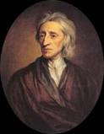
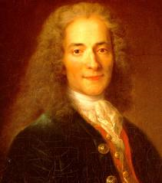
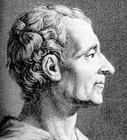
Enlightened thinker’s thoughts
Voltaire
Disliked the privileges of nobles in France
Spoke out against the church’s authority
Valued freedom of speech, thought, and expression
“I may not agree with a word that you have said, but I will defend to the death your right to say it.”

Slide 7
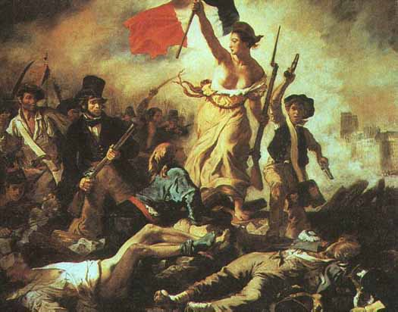
Causes: Philosophic
The American Revolution
The American Revolution (1776-1783) was inspirational to people in France.
It showed the people the enlightenment ideals in action.
French soldiers and officers came home inspired.
Liberty leading the People, Eugene Delaxcroix

Slide 8
Causes: Economic
France’s involvement in the American Revolution was expensive and left them with a large debt to be repaid
They were still trying to recover from the Seven Year’s War with England
Taxation was uneven throughout the country and classes
Tolls had to be paid to move throughout the country as a person and on goods
The Church still demanded a 10% tithe
There was no central bank or common currency

Slide 9
Causes: Social/Political
France still used the feudal system that had existed since the dark ages!
This made life for peasants extremely hard and they resented the inequality of French society
The middle class of the Third Estate could not move upward in society unless they were VERY rich.
The estate system was really out of date
First estate – clergy and church
Second estate – aristocracy, kings, nobles
Third estate – everybody else

Slide 10
Causes: Social/Political
A peasant’s life was unbearable
Overtaxed, land-starved, starved of food, and taken advantage of by the nobles.
Failed harvests lead to a decrease in available food and increase in prices (supply<demand)
Leads to business failure and unemployment in cities. WHY??

Slide 11
History through Images
What about this image?
What do you learn about the estates from this image?
Does this image reaffirm your thoughts from the first image?
Can you make a connection to this image?

